Slide 1
Oct 27, 2023
BBBSEM x IUCG: Modernizing Making A Difference
Phase 1: Documentation and Bottleneck Identification
Spencer Friedman, James Stevens, Meredith Graeyer, Sankalp Koripalli, Selvana Abdelmesih

Slide 2
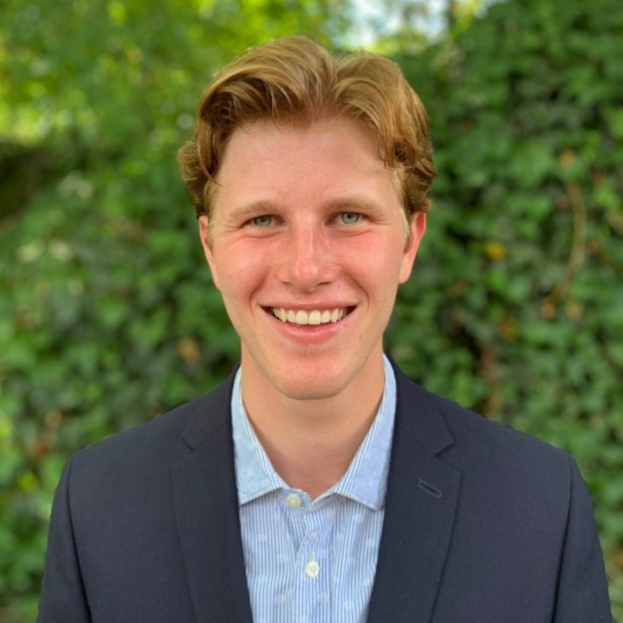
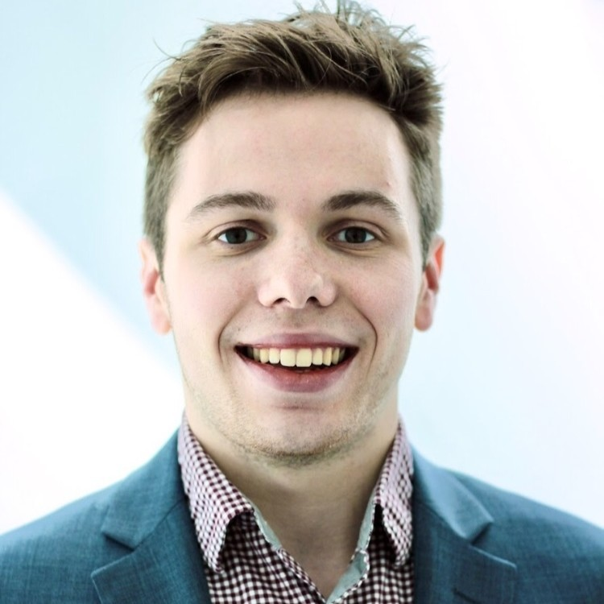
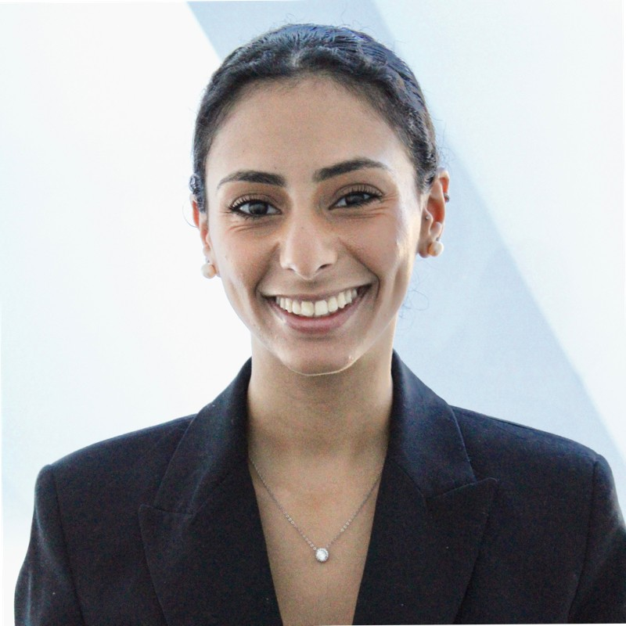
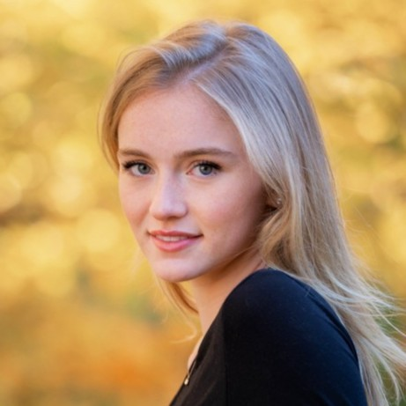
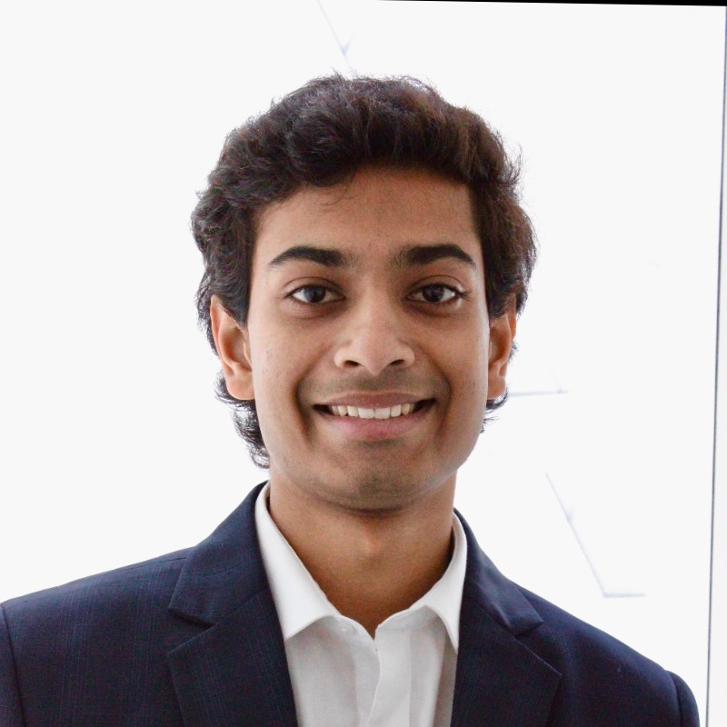
Meet the Team!
Spencer Friedman
Project Manager
Informatics ‘24
James Stevens
Senior Advisor
Accounting ‘24
Selvana Abdelmesih
Senior Analyst
Finance + Political Science ‘24
Meredith Greayer
Analyst
Mathematics ‘25
Sankalp Koripalli
Analyst
Economics ‘26

Slide 3
Agenda
Background and Methodology
1
Introduction to the problems faced by BBBSEM in recent years
Overview of IUCG’s discovery methodology over the last 6 weeks
A Big’s Journey From Inquiry to Match
Analyzing flows used to automate communication processes with inquiring mentors
Documenting flaws and gaps in communication that may lead to confusion in interview process
2
3
Next Steps
3
Outlining problems discovered in current communication process
Laying out timeline for modifications and testing of changes

Slide 4

Leveraging both qualitative and quantitative sources, IUCG captured a holistic view of the challenges restricting BBBSEM’s recruiting process from achieving best-in-class status
Business Needs
Leading Questions
Our Approach
What is current standard practice for communication?
What areas have you meant to investigate further?
What would you like to see from our findings?
Conducted 3 interviews with: Caitlin McNee, Aka Denjongpa and Kara Hopkins
Understood stakeholder responsibility in recruitment and surface any underlying flaws
Gathered resources not in Salesforce
Decreasing conversion rates from inquiry to interview and match
Changing user expectations increased need for personalization
Staff turnover limited institutional knowledge
Lack of capacity to conduct strategic review
How would we as outsiders perceive content form BBBSEM?
How are different processes connected in the journey?
How can this information be best recorded for distribution?
Inspected all flows related to recruiting Bigs and Littles into program
Recorded flaws in outreach wordage and structure for execution in next phase of project
Documented outreach to create comprehensive guide for BBBSEM

Slide 5






Bigs move through three distinct stages in the BBBSEM with varying levels of communication
Marketing
Top of Funnel
Middle of Funnel
Bottom of Funnel
BBBSEM Ads
Interview
Programming
24% Retention*
81% Retention*
~30 Days*
2-9 messages
via email and text
~1-5 Months*
4 potential emails
Website Form
Start of Match
Recruitment
Top of Funnel
Middle of Funnel
Bottom of Funnel
Recruiting Event
Programming
23% Retention*
81% Retention*
~ 39 Days*
2-9 messages
via email and text
~1-5 Months*
4 potential emails
Website Form
Start of Match
* 2022 Salesforce Data

Slide 6







Potential Bigs enter the funnel through 4 different avenues with varying levels of modernization & ease
Through analysis of the various entries to the funnel, we identified potential problems with the option to RSVP after an event and an inefficient handoff from CEE to CRS after filling in the inquiry form.
Areas of Entry Connection Point Form on Website
CEE Form
1.
2.
3.
4.
Community Events & Engagement
QR Code
Marketing (Instagram & Facebook)
Inquiry Form (Old)
Link to Form
Referral Guided Interest
Inquiry Form (New)
General Curiosity/ Word of Mouth
BBBSEM
Website
1, 2, 3, 4, 5: Refer to Appendix D

Slide 7





Utilizing BBBSEM’s Salesforce Flows, IUCG organized all VIP flows to display communication frequency and illustrate interview confirmation exit and corresponding flow
Push to Interview
Push to Chat (CEE)
Push to Chat (CRS)
Default VIP Message
Potential volunteers receive between 2 and 6 emails and texts over 7 days. At any point, volunteers may schedule their interview, removing them from their funnel and halting recruiting correspondence. Once scheduled, a volunteer will be emailed at most 3 additional times prior to their interview.
VIP mentor outreach 1³
VIP learn more outreach 1⁴
VIP no notes outreach 2⁵
VIP email
1⁶
Immediate Actions¹
0D
VIP mentor SMS 1
VIP learn more SMS 2
VIP no notes SMS 1
VIP
SMS
VIP mentor outreach 2³
VIP learn more outreach 2⁴
VIP no notes outreach 3⁵
VIP email
2⁶
0D
- 14D
- 1D
2D
Interview Confirmed⁷
VOL
Interview Booked / Confirmation Zoom PILOT⁸
VOL Interview Confirmation 2 Zoom PILOT⁸
VOL Interview Confirmation Final Zoom PILOT⁸
Call
Call
Call
Call
Interview
3D
VIP Mentor SMS 2
VIP no notes SMS 2
VIP Mentor SMS 2
VIP Mentor SMS 2
3day
SMS 1
VIP Mentor SMS 2
VIP learn more SMS 3
VIP mentor SMS 2
Scheduled Actions²
18day VIP
SMS 1
6D
VIP mentor outreach 3³
VIP learn more outreach 3⁴
VIP no notes outreach 3⁵
Call
Call
Call
Call
VIP email
3⁶
7D
VIP mentor SMS 3
VIP learn more SMS 3
VIP no notes SMS 3
10D
Close Volunteer
1, 2, 3, 4, 5, 6, 7, 8: Refer to Appendix E

Slide 8




IUCG analysis shows current communication flows lack direction and don’t optimize engagement
While there is no automated Salesforce flow for post-interview communications, this highlights the general timeline of ad-hoc messages sent during this phase.
24 hours post interview
Processing Update
Potential follow up interview
Success
Match Confirmed
Interview
RTBM
Match
81% Retention
Expected: 15 days
Actual: 1-5 months
Refer to Appendix D for Big and Little Email Templates Communications

Slide 9


A consistent communication flow and recurring updates can maintain engagement and excitement
Key Elements of Current Communication
Opportunities for Improvement
Standardization
1
Standardize Post-Interview Flows
There is no Salesforce flow for the post-interview phase and no clear timeline for communications, where most messaging is ad-hoc
Develop Salesforce flows for automation for post-interview communications
Continue to use ad-hoc communication when necessary
Email Content
2
Provide Engaging Content
Email content is generic and repetitive - providing little-to-no information on application status or progress
Create more intentional email templates that serve a purpose by including creative and up-to-date content
Foster engagement by creating content that is interactive to preserve excitement for volunteering
Areas for Concern
3
Include Status Updates
1
Lack of standardization creates inconsistencies
Create a model that provides volunteers with a timeline or status update to keep candidates well-informed
Utilize status updates to help maintain momentum and enhance applicant perception of BBBSEM
2
Repetitive content results in lack of engagement
3
Loss of momentum can lead to feeling neglected
Refer to Appendix D for Post – Interview Big Communication – Processing

Slide 10




IUCG has identified three areas for impactful change to the volunteer recruiting funnel after thorough review of BBBSEM’s processes and communications
01
02
03
Recruiting to Funnel Transition
Pre-Interview Task Assignment
Post-Interview Alignment
There is currently confusion around the post-event RSVP and handoff from CRS to CEE team that may leave potential volunteers feeling confused and disconnected
The current inquiry forms and emails lack direction for the potential volunteers and external survey conveys confusion some volunteers had with pre-interview to-dos
Communication during background check and referral collection can be difficult to coordinate due to sensitivity constraints, and as such potential RTBM Bigs are often left in limbo
Issue Statement
RSVP after events may be confusing
CEE to CRS pass results in impersonal messaging
End of inquiry form does not cue inquirer to forms in email
Format makes forms hard to find + downplays importance
Lack of formalized communication flow
Ad-hoc communication creates inconsistencies
Granular Problems
Change form structure to differ response once option for post-event is selected for RSVP
Update post-CEE flows to minimize confusion in handoffs
Revise communications to prepare volunteers for pre-interview forms
Create best practices informed by engagement behaviors
Establish standardized flow of communication in Salesforce for post-interview process
Provide value status updates to keep volunteers engaged
Next Steps

Slide 11
Timeline for Phase 2 up to final Deliverable
10/30
11/6
11/13
11/20
11/27
12/4
12/8
Identify places of CRS & CEE confusion
Develop required modifications to streamline
Transfer implementable changes to flows
Top of Funnel
Research alternative to Post-Event RSVP
Create alternative to replace ‘RSVP’ post-event
Develop A/B Test for after vs before Pilot
Research email best practices driven by volunteer data and conversion rates
Analyze communications alongside findings
Organize suggestions
Middle of Funnel
Collate emails requiring reordered content
Build prioritized content list for all communications
Offer tangible revisions, emphasizing required forms
Research email best practices
Build Email Prototypes
Develop A/B Tests for Varying Sequences
Bottom of Funnel
Develop Engaging Content
Create Timeline of Communications
Establish Standardized Flow

Slide 12
Any Questions?

Slide 13
Appendix Table of Contents
Appendix A: Process Flow for Littles
Appendix B: Overview of Tools______
________________ ________
Appendix C: Historical Conversion Rates for BBBSEM___
________
Appendix D: Interest to Inquiry_
_____________________ _________
Appendix E: Inquiry to Interview_
_____________________ _______
Appendix F: Post – Interview______________________ __________
Page No.
14
21
23
25
31
40

Slide 14
Appendix A: Process Flow for Littles

Slide 15






Little Journey Process High Level Overview
BBBSEM Outreach
Permission slips signed by families
Start of Match
Teachers distribute material
Interview
Programming

Slide 16
Inquiry to Match Process Flows: Little
Immediate Actions
Scheduled Actions
Aggressive
3 emails and 2 texts over 5-21 days
Close Youth
Immediate Actions
1 Email—content dependent on interview medium (Facetime, Zoom, or Google)
Standard
3 emails and 1 text over 14-28 days (& equivalent flow in Spanish)
Close Youth
All receive 1 email,1 text, and 3 scheduled calls for 1 day, 6/7 days, and 11/18 days post-inquiry.
Virtual
3 emails and 1 text over 5-28 days
Close Youth
7 Days Before
1 Email—content dependent on interview medium (Facetime, Zoom, or Google)
COVID-19 Outreach
3 emails and 1 text over 5-28 days (& equivalent flow in Spanish)
Close Youth
Passive
Receives 1 email and 1 scheduled call after 1 day.
Potential littles receive 1-7 emails and texts over 21-28 days, depending on their funnel. At any point, littles may schedule their interview, removing them from their funnel and halting recruiting correspondence. Once scheduled, a little will be emailed at most 2 additional times prior to their interview.
Close Youth
Interview

Slide 17
Post Interview Process Flows: Little
60 Day Outreach
120 Day Outreach
180 Day Outreach
240 Day Outreach
Match Confirmed
Interview
RTBM
Match

Slide 18
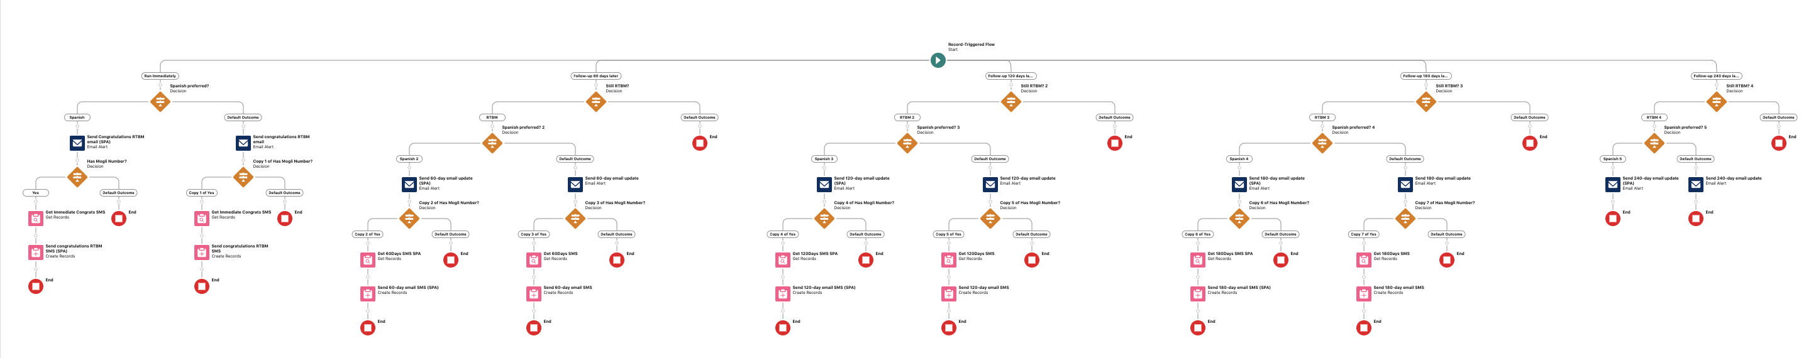
Appendix: Post – Interview: Flow Used for Little Communication
Flow Name: CB Youth Contact: RTBM – V3

Slide 19
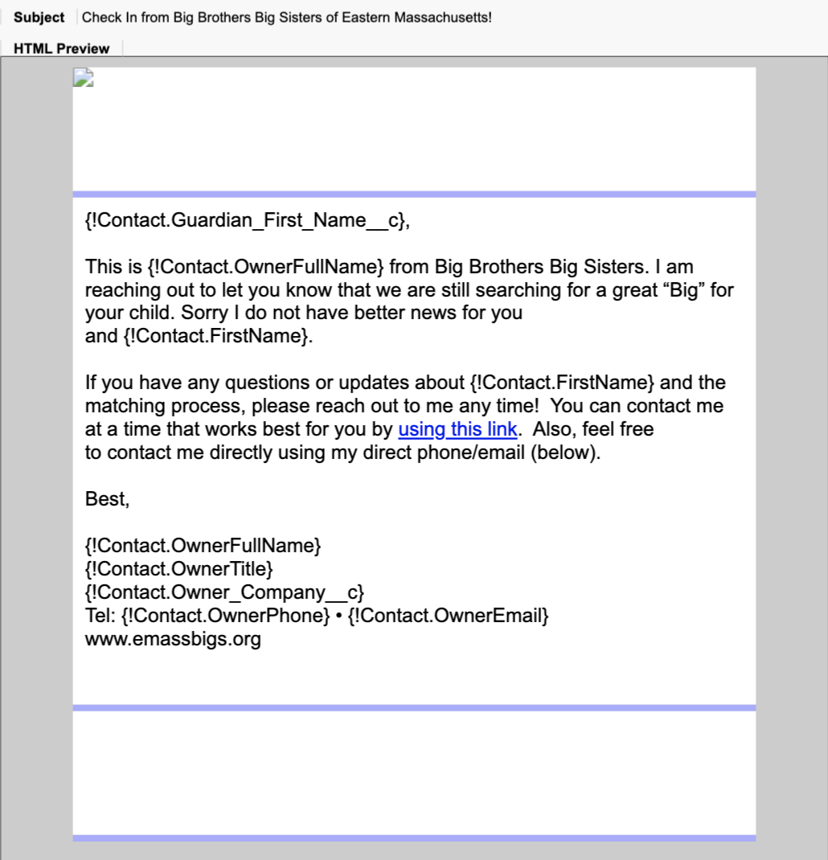
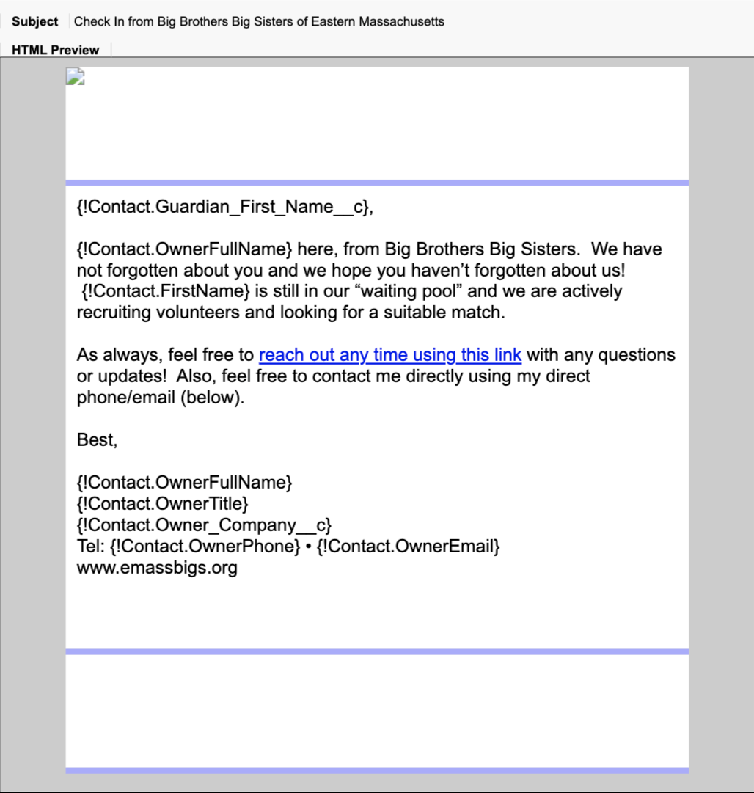
Appendix: Post – Interview: Updates Sent to Little Email Template
Template Name: Youth RTBM Email d60
Flow Used: CB Youth Contact: RTBM – V3
Template Name: Youth RTBM Email d120
Flow Used: CB Youth Contact: RTBM – V3

Slide 20
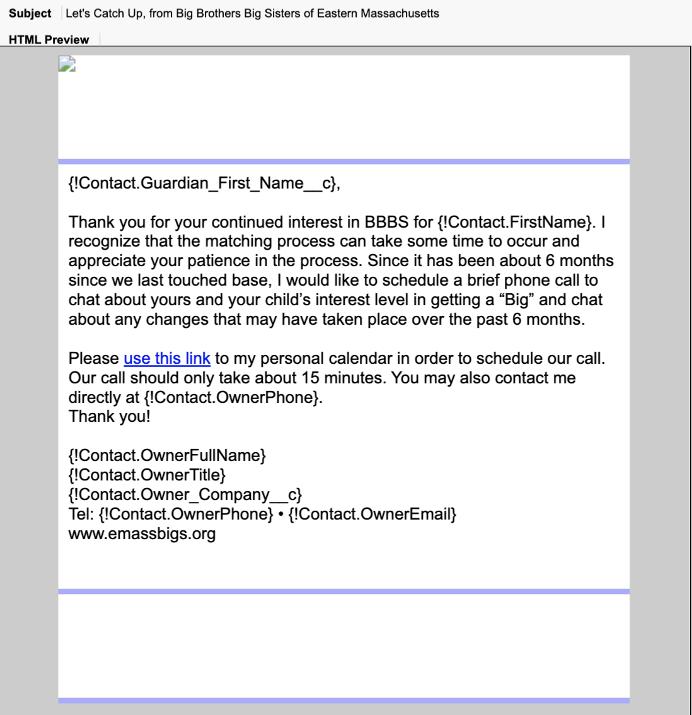
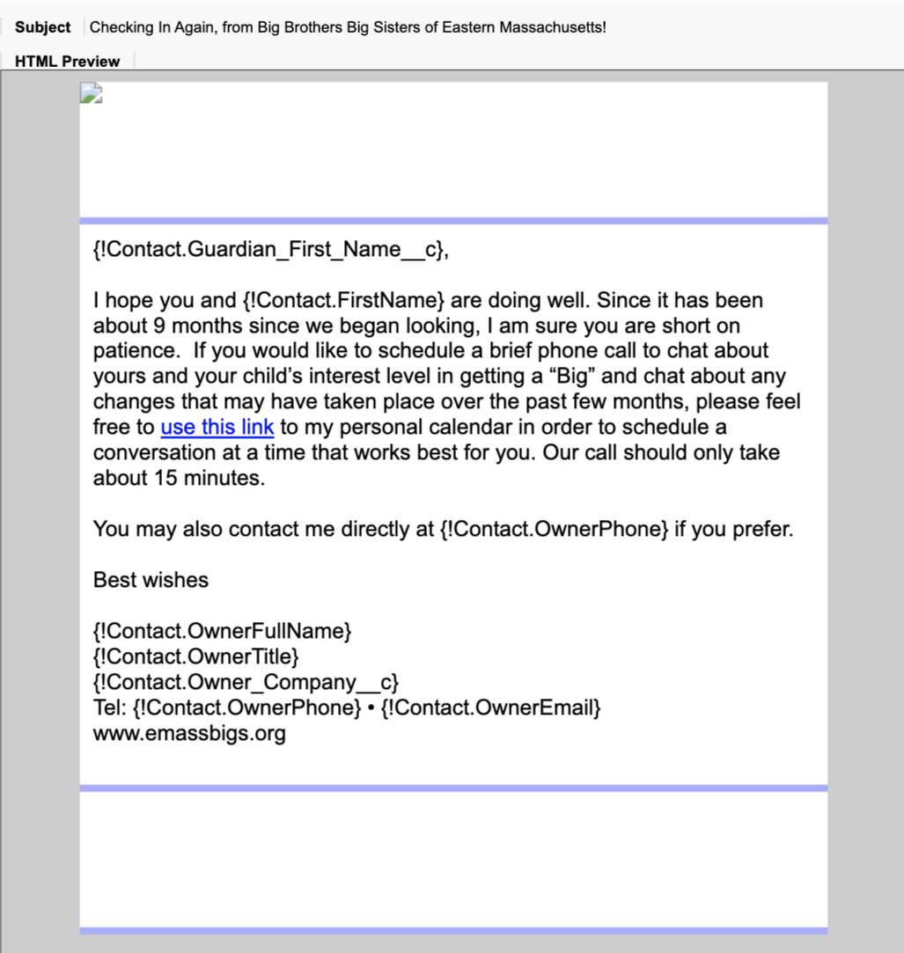
Appendix: Post – Interview: Updates Sent to Little Email Template
Template Name: Youth RTBM Email d180
Flow Used: CB Youth Contact: RTBM – V3
Template Name: Youth RTBM Email d240
Flow Used: CB Youth Contact: RTBM – V3

Slide 21
Appendix B: Overview Of Tools

Slide 22
Tools High Level
Tool | Where it’s used? | How it’s used?
Mogli | Used to communicate with candidates from inquiry to interview and beyond | Allows for more modern communication medium Allows for easier ad hoc communication
Salesforce Emails | Automation of outreach via email and SMS Record keeping | Allows for flow creation and maintenance Keep track of candidate progress and info
Acuity | Interview scheduling form for prospective volunteers and general data collection tool | Allows volunteer to schedule interview time Informs Salesforce to change volunteer status
Formassembly | Collect user information in pre-interview process | Hosts volunteer application and referrals Integrates data into Salesforce profile

Slide 23
Appendix C: Historical Conversion Rates For BBBSEM

Slide 24
Trends in Conversion Rates from Inquiry to Match
Inquiry to Interview
Interview to Match
2018: 41.4%
2019: 35.8%
2020: 29.5%
2021: 25.9%
2022: 23.9%
2023: 23.6%*
2018: 65.1%
2019: 64.8%
2020: 71.0%
2021: 52.4%
2022: 80.7%
2023: 69.5%*
* 2023 numbers are not complete as recruiting is ongoing

Slide 25
Appendix D: Interest to Inquiry

Slide 26
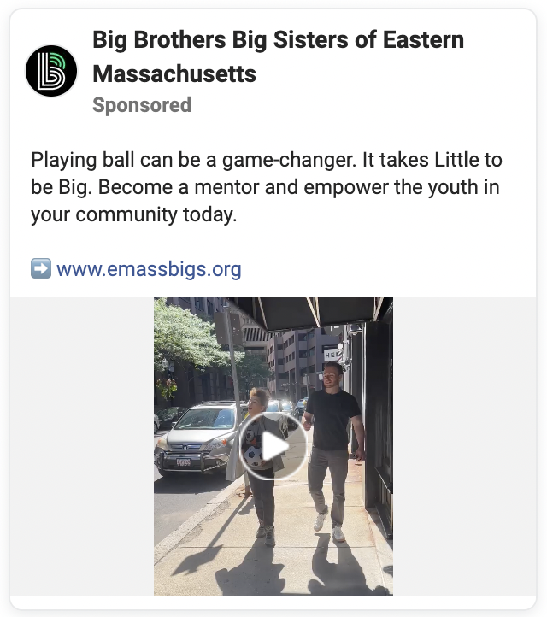
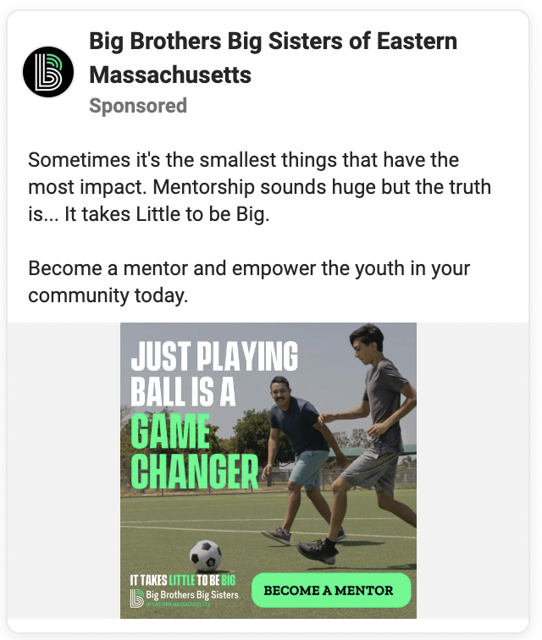
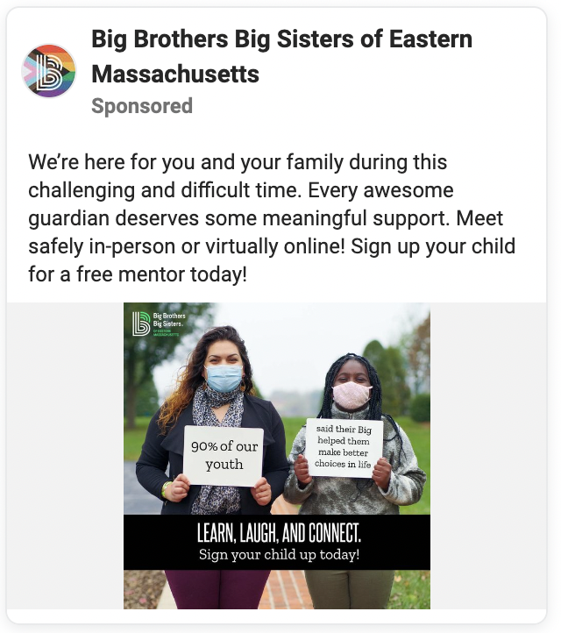
Appendix: Interest to Inquiry: 1. Facebook Advertisements
Advert 1 (10.11.23) Advert 2 (10.11.23) Advert 3 (3.10.23)

Slide 27
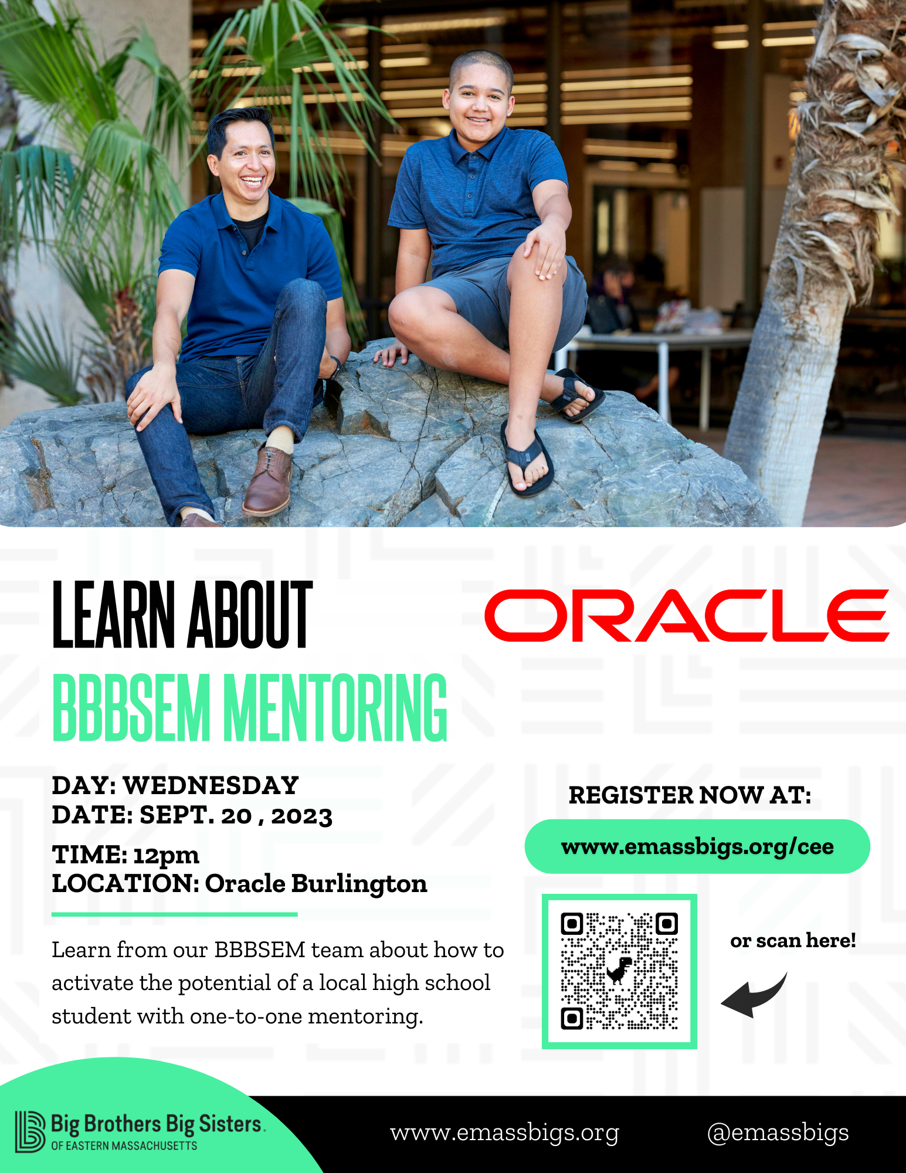
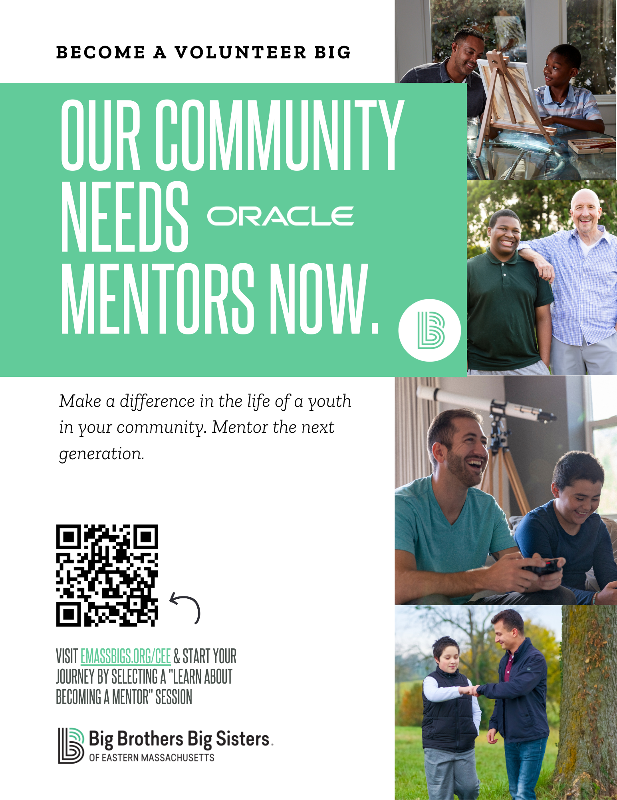

Appendix: Interest to Inquiry: 2. Outreach Flyers
Outreach Flyer 1 Outreach Flyer 2 Outreach Flyer 3

Slide 28
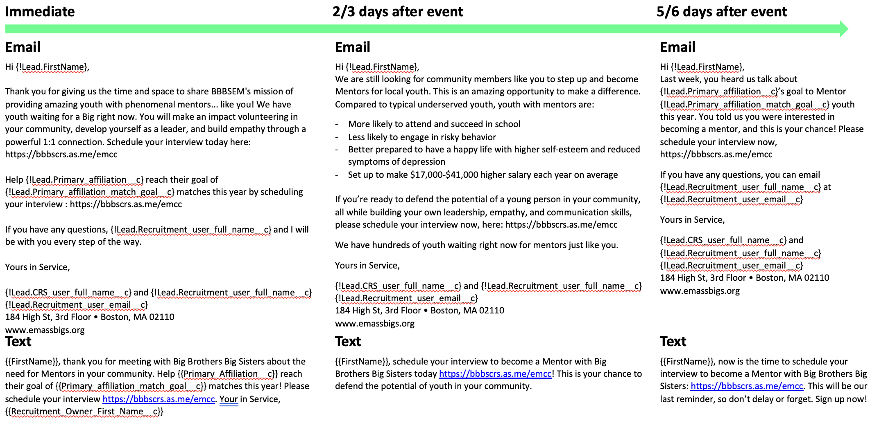
Appendix: Interest to Inquiry: 3. VIP Outreach Status: ‘Wants to be mentor’

Slide 29
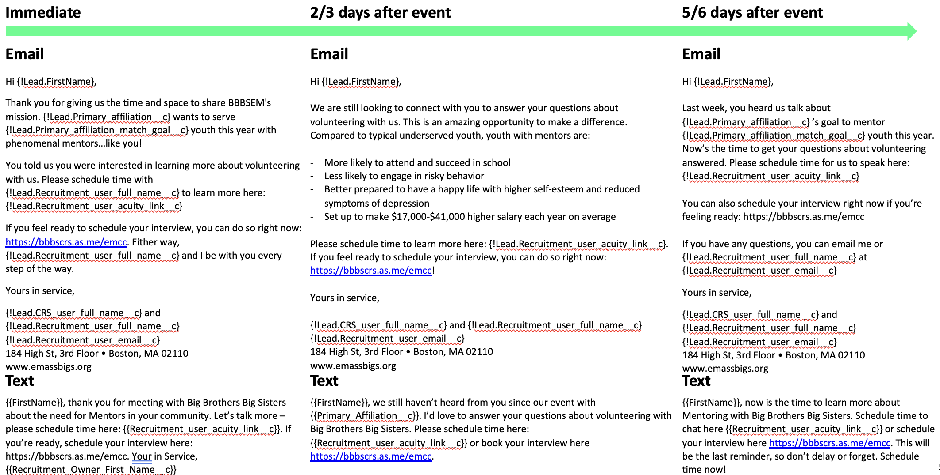
Appendix: Interest to Inquiry: 4. VIP Outreach Status: ‘Wants to learn more’

Slide 30
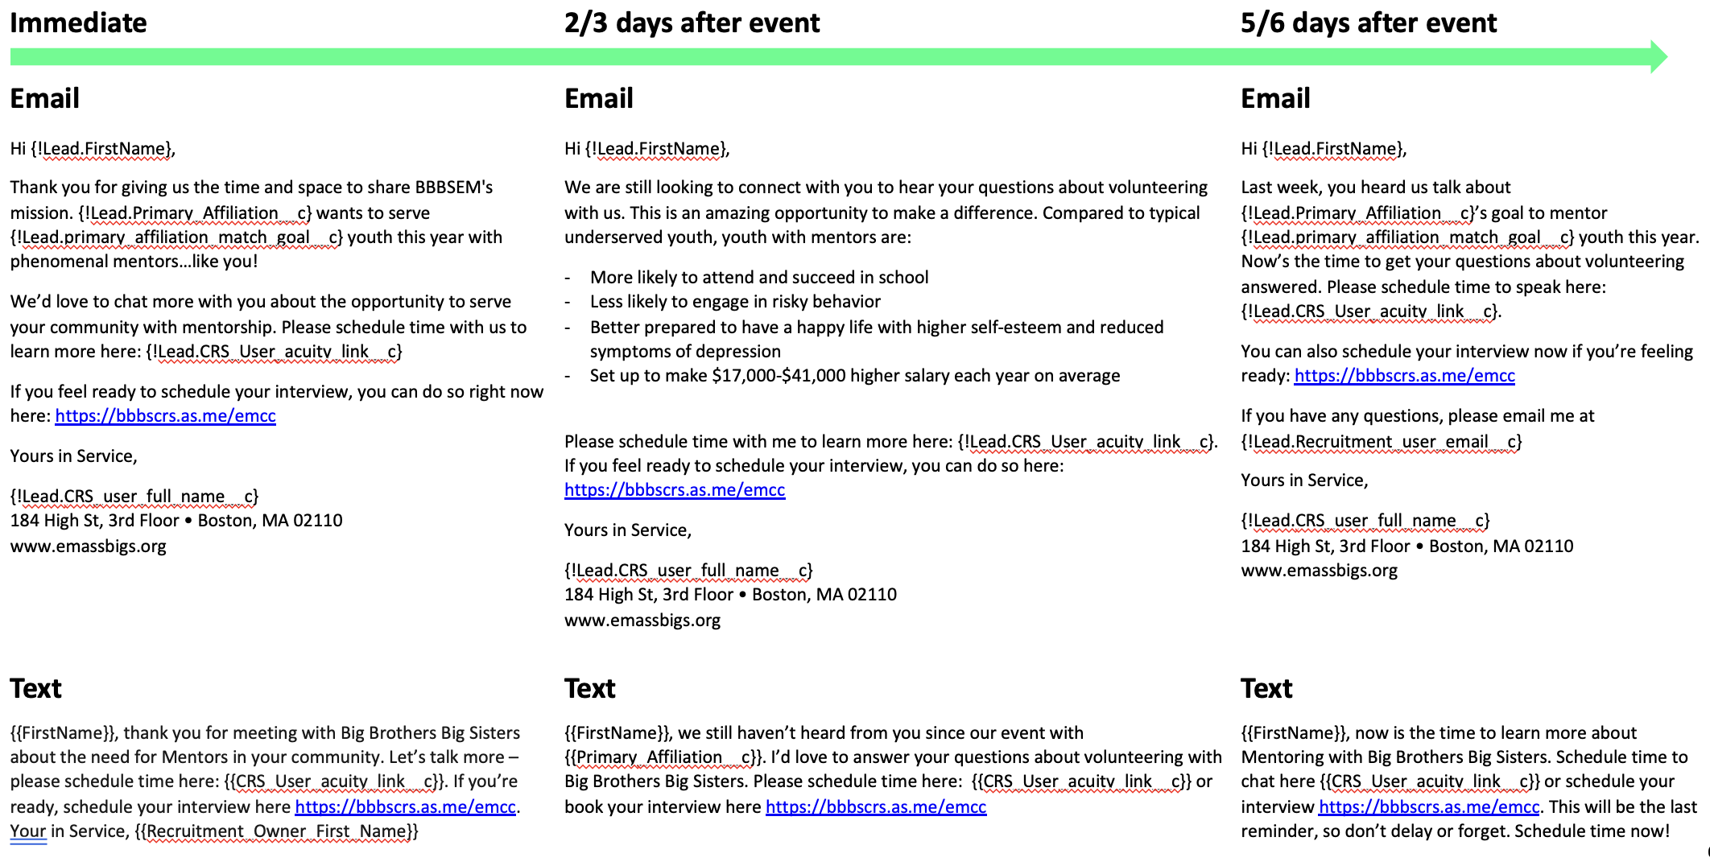
Appendix: Interest to Inquiry: 5. VIP Outreach Status: BLANK STATUS

Slide 31
Appendix E: Inquiry to Interview

Slide 32
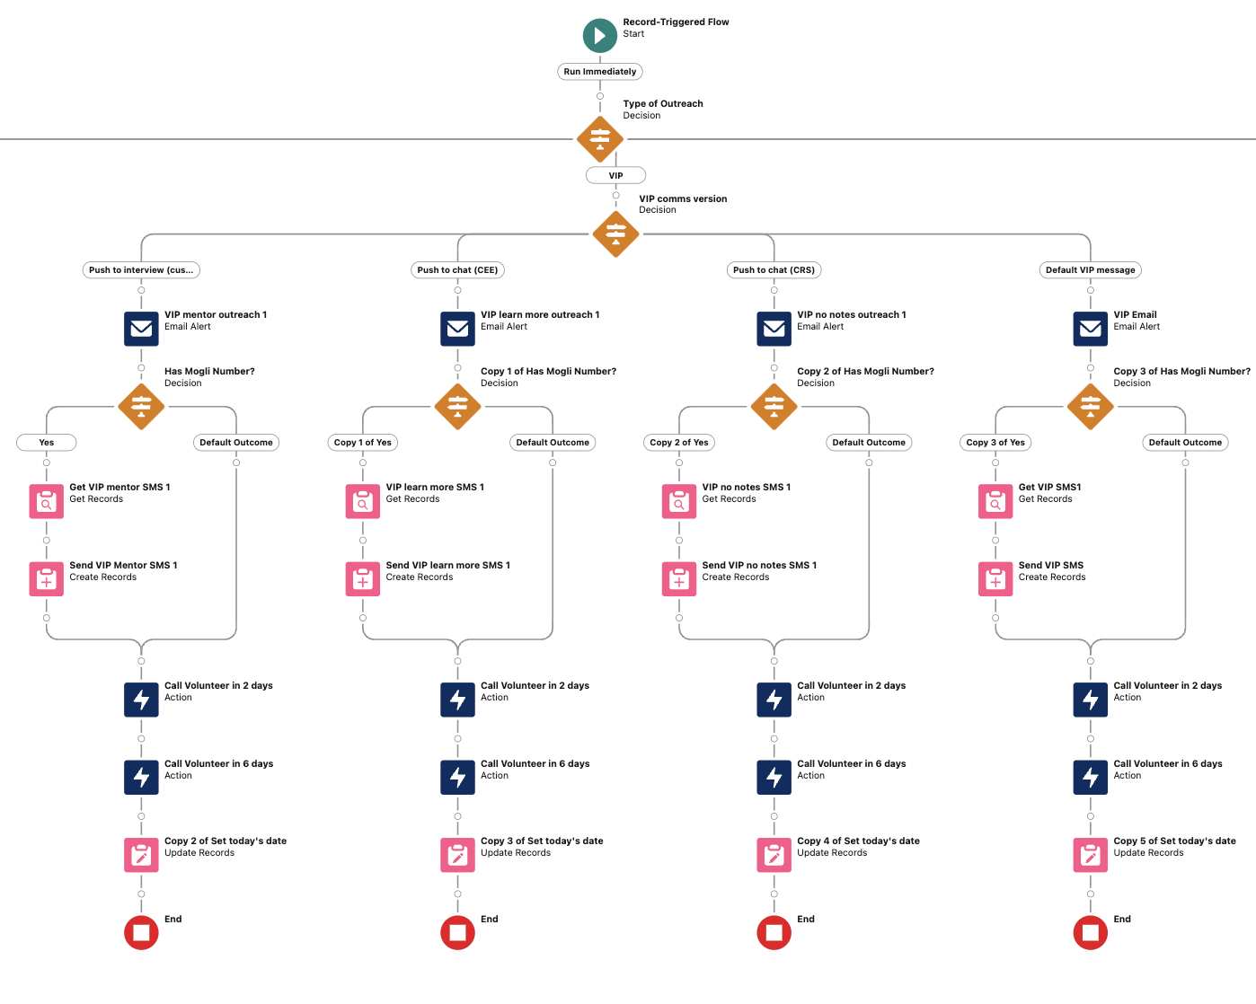
1. Immediate Actions
Flow: Volunteer Outreach || Immediate Actions - V16

Slide 33
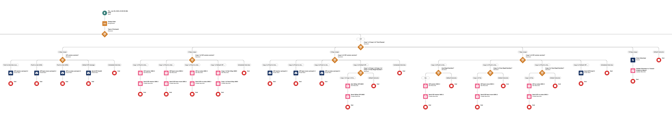
2. Scheduled Actions
Flow: Volunteer Outreach || Scheduled Actions - V19

Slide 34
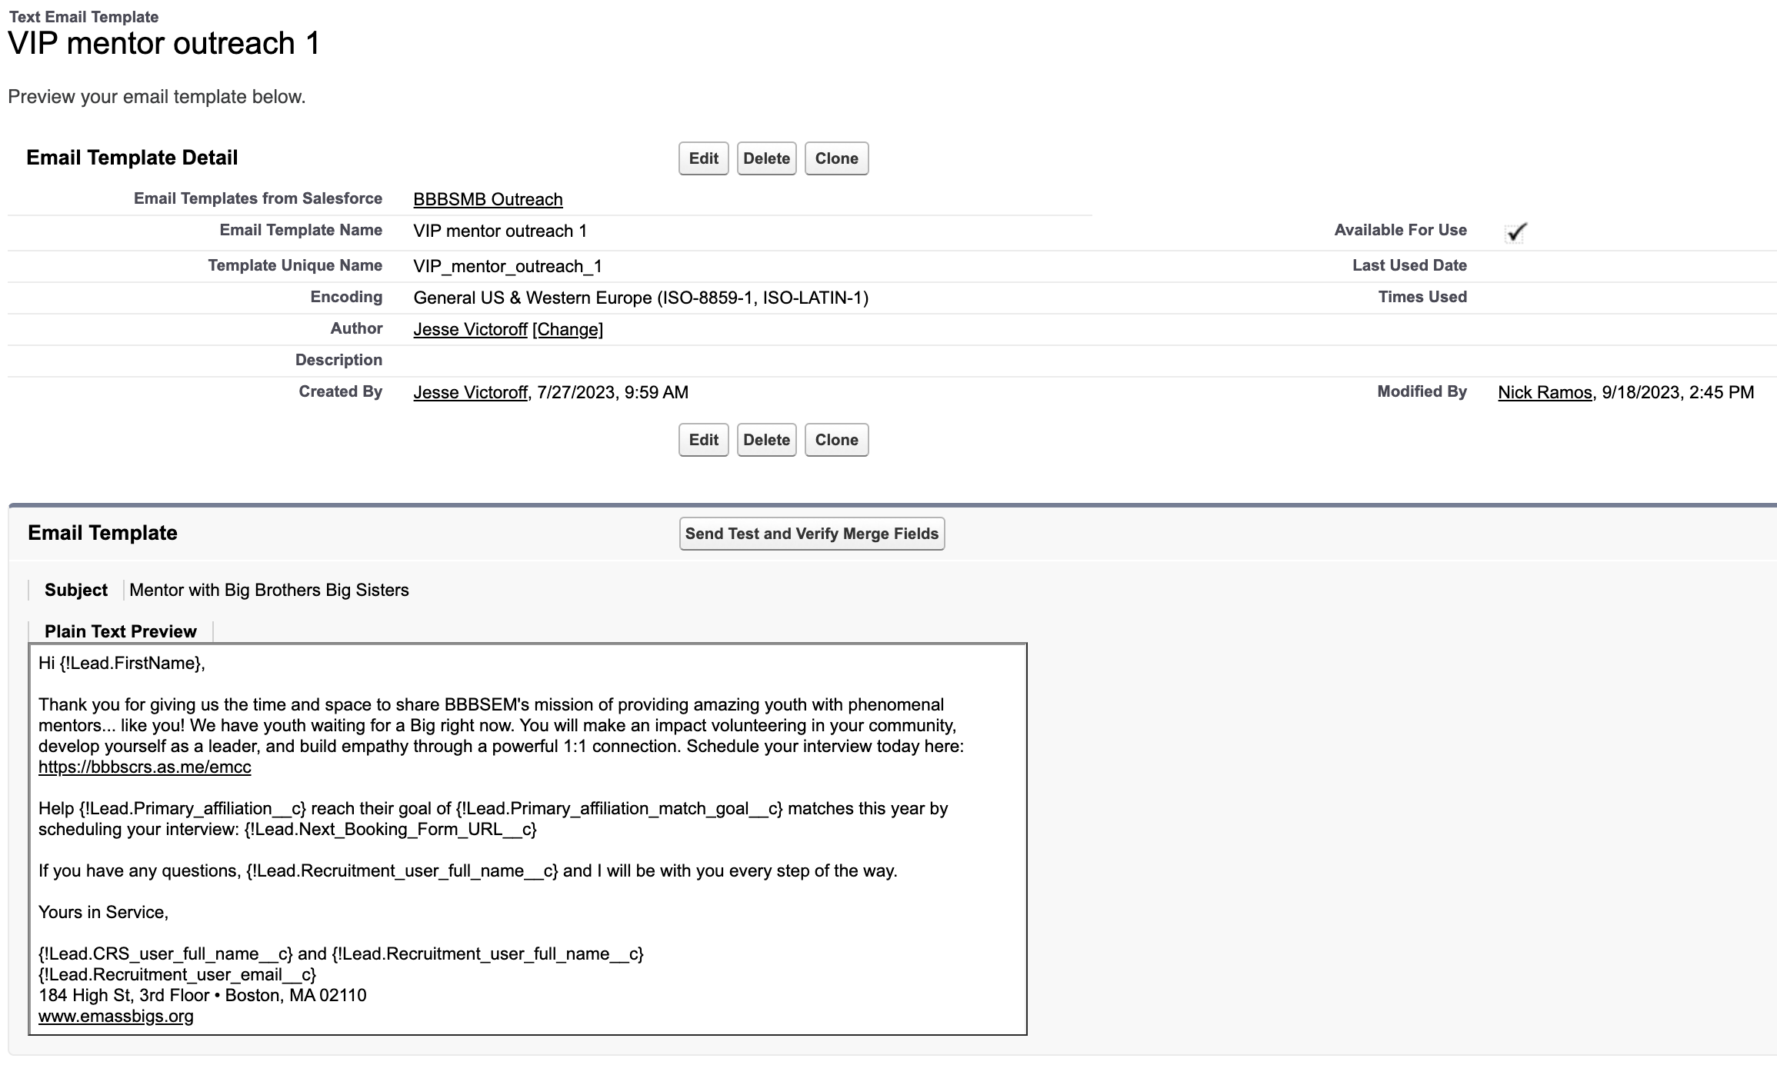
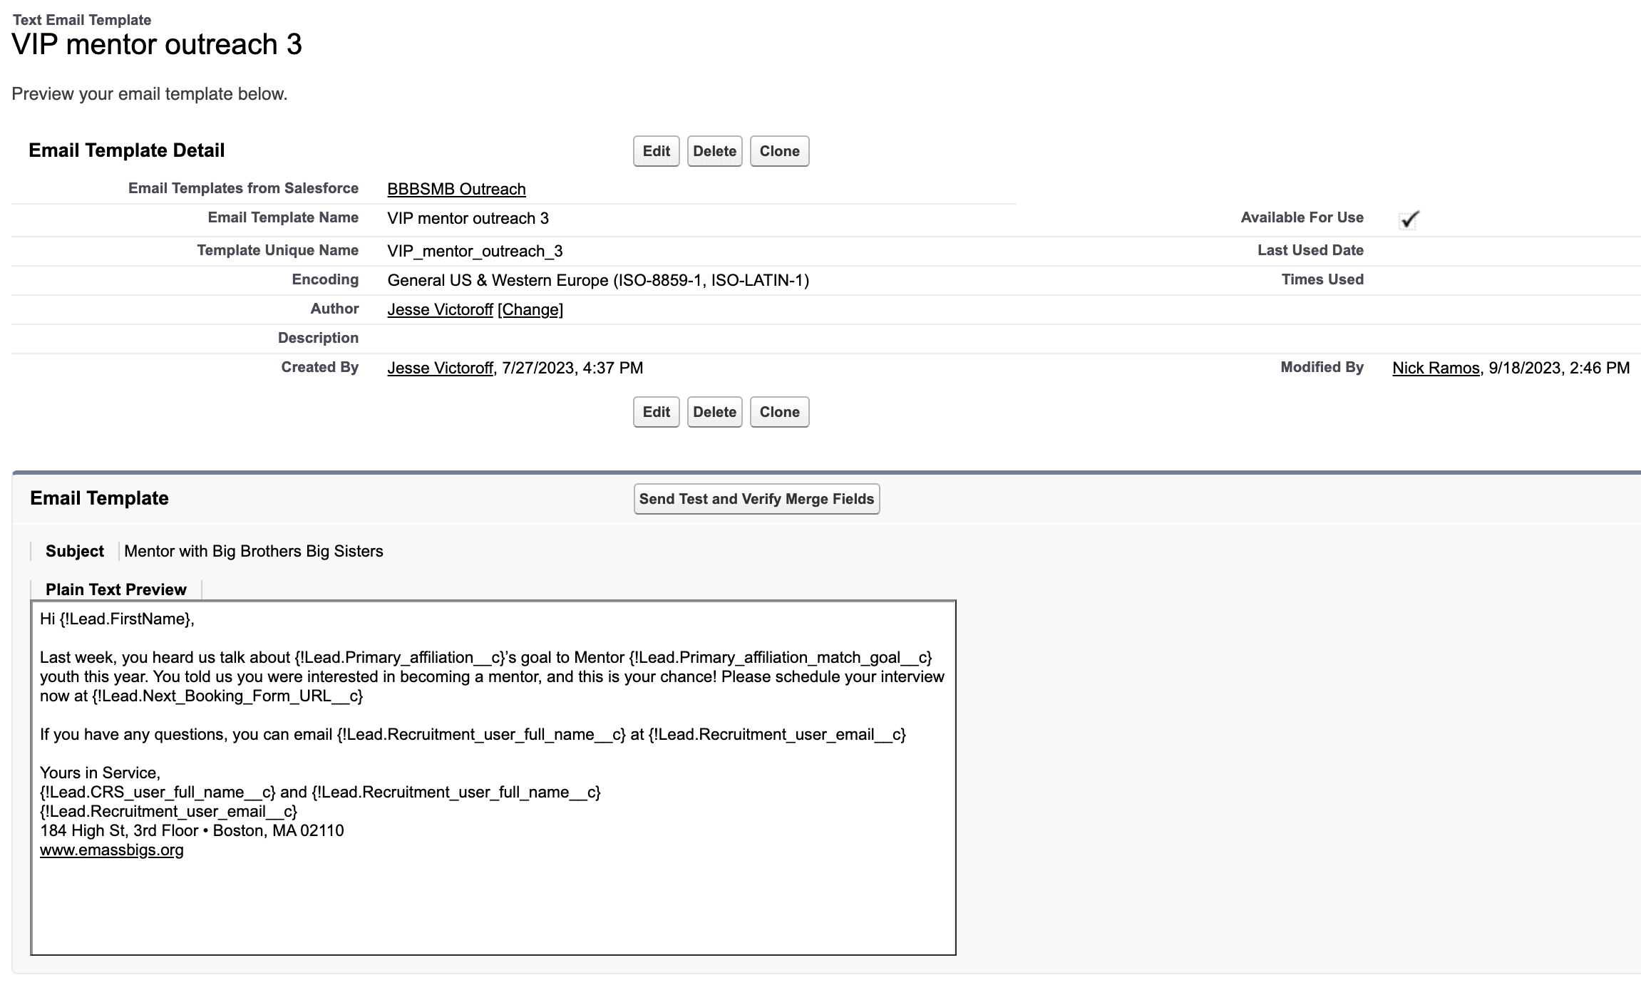
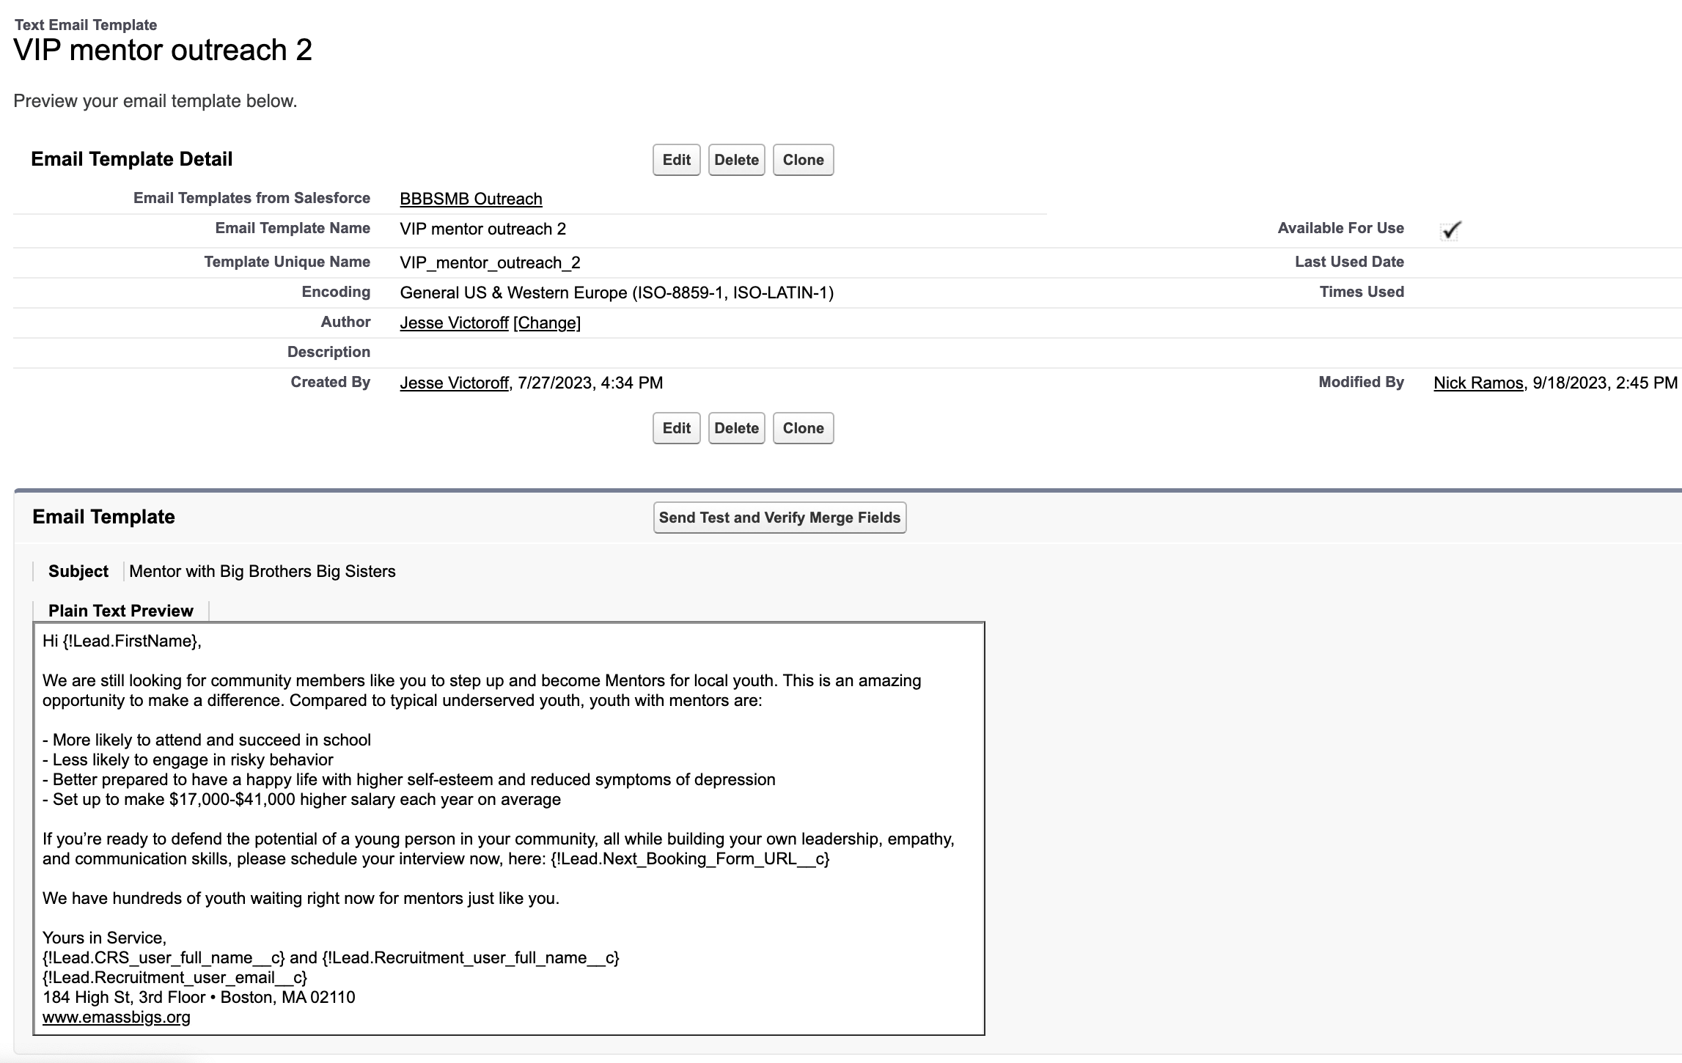
3. Push to Interview
Template Name: VIP mentor outreach 1
Flow Used: Volunteer Outreach || Immediate Actions - V16
Template Name: VIP mentor outreach 3
Flow Used: Volunteer Outreach || Scheduled Actions - V19
Template Name: VIP mentor outreach 2
Flow Used: Volunteer Outreach || Scheduled Actions - V19

Slide 35
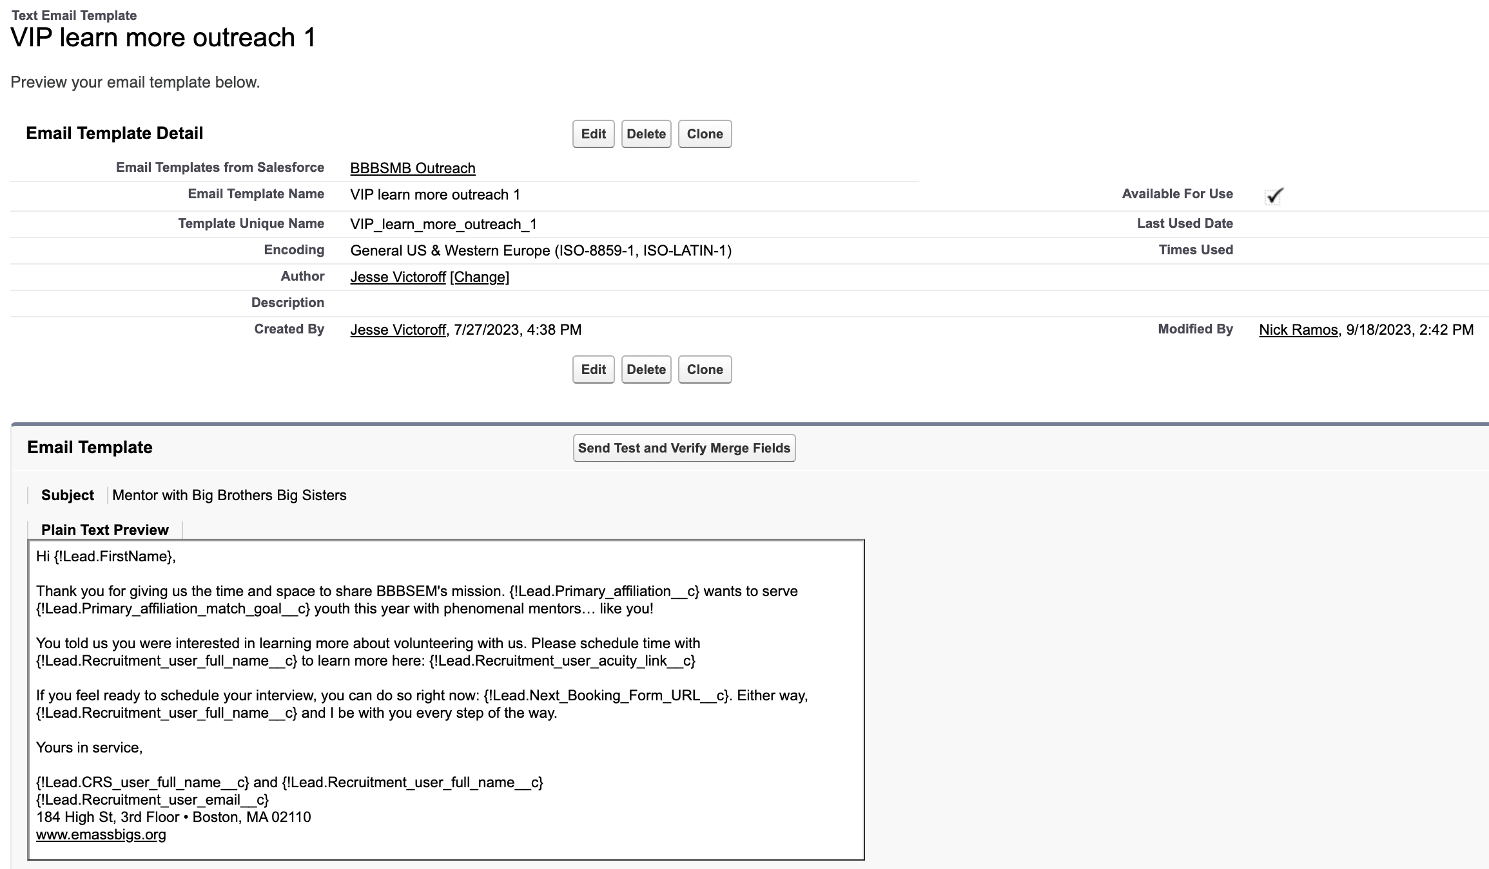
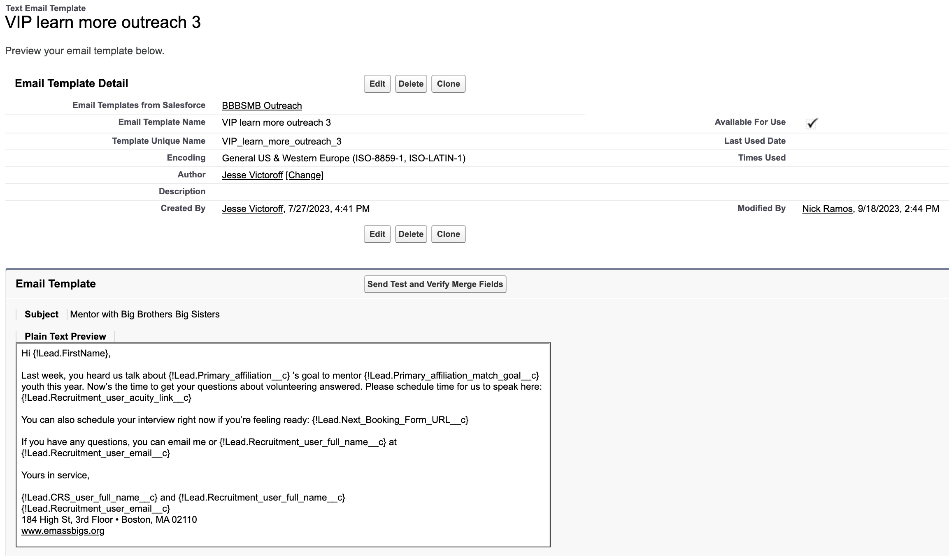
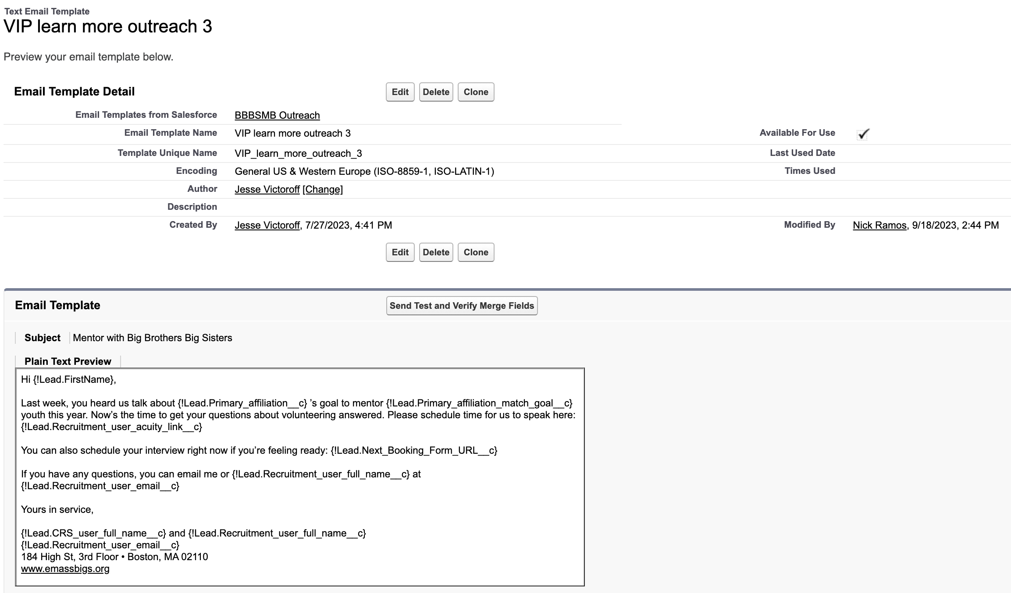
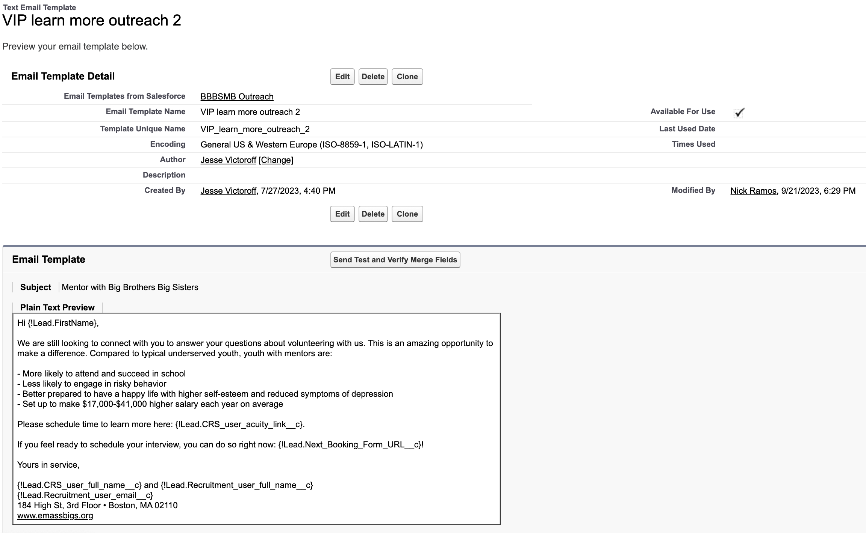
4. Push to Chat (CEE)
Template Name: VIP learn more outreach 1
Flow Used: Volunteer Outreach || Immediate Actions - V16
Template Name: VIP learn more outreach 3
Flow Used: Volunteer Outreach || Scheduled Actions - V19
Template Name: VIP learn more outreach 2
Flow Used: Volunteer Outreach || Scheduled Actions - V19

Slide 36
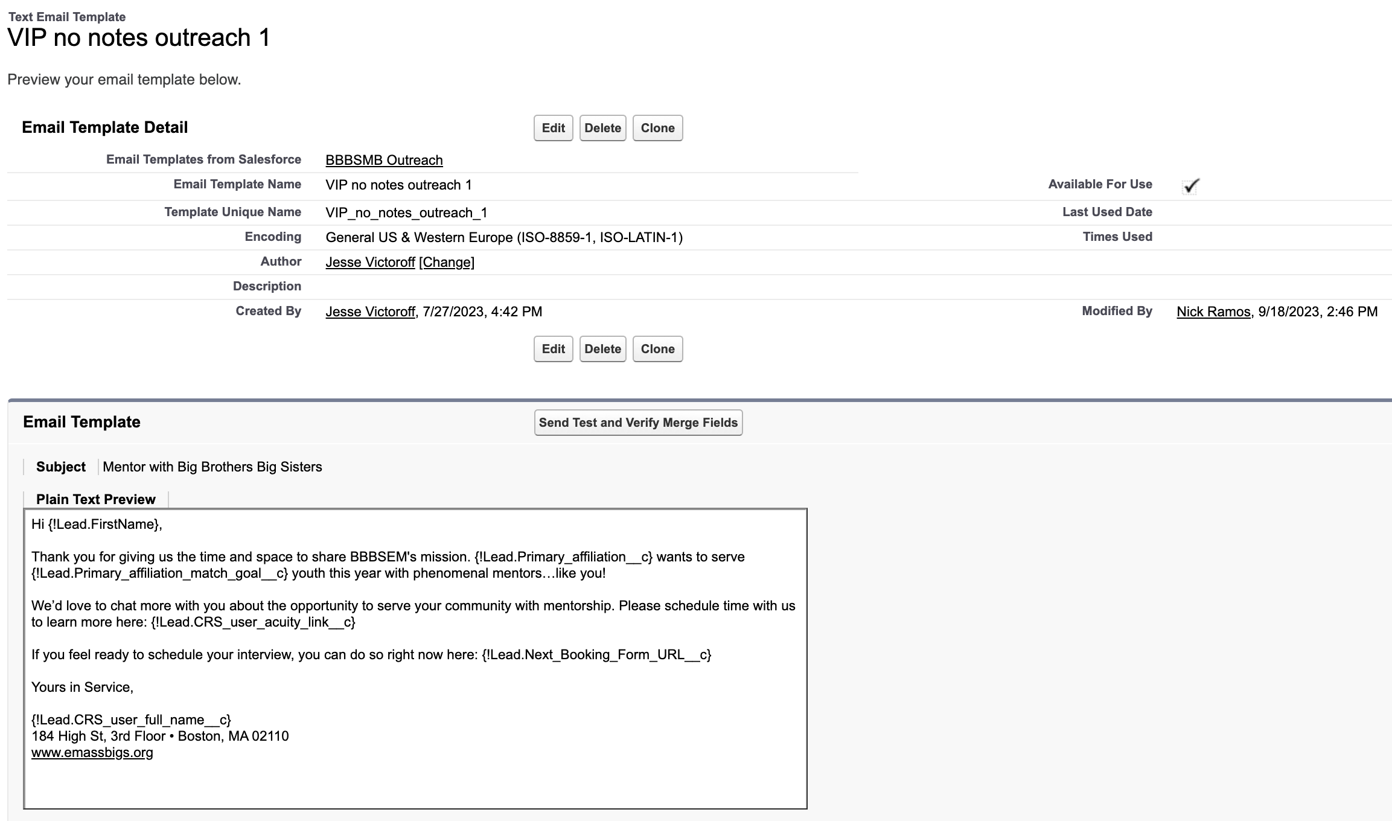
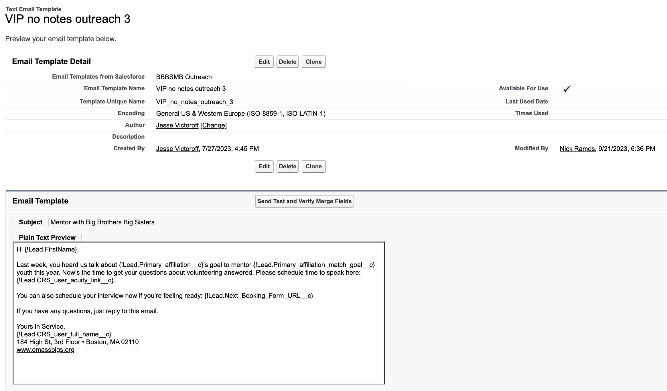
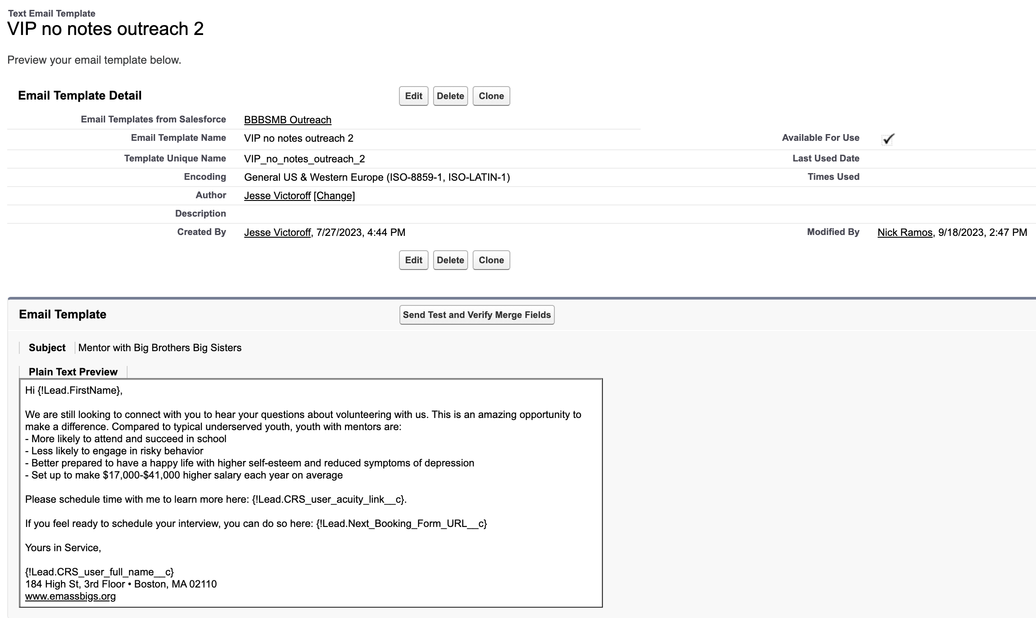
5. Push to Chat (CRS)
Template Name: VIP learn more outreach 1
Flow Used: Volunteer Outreach || Immediate Actions - V16
Template Name: VIP learn more outreach 3
Flow Used: Volunteer Outreach || Scheduled Actions - V19
Template Name: VIP learn more outreach 2
Flow Used: Volunteer Outreach || Scheduled Actions - V19

Slide 37
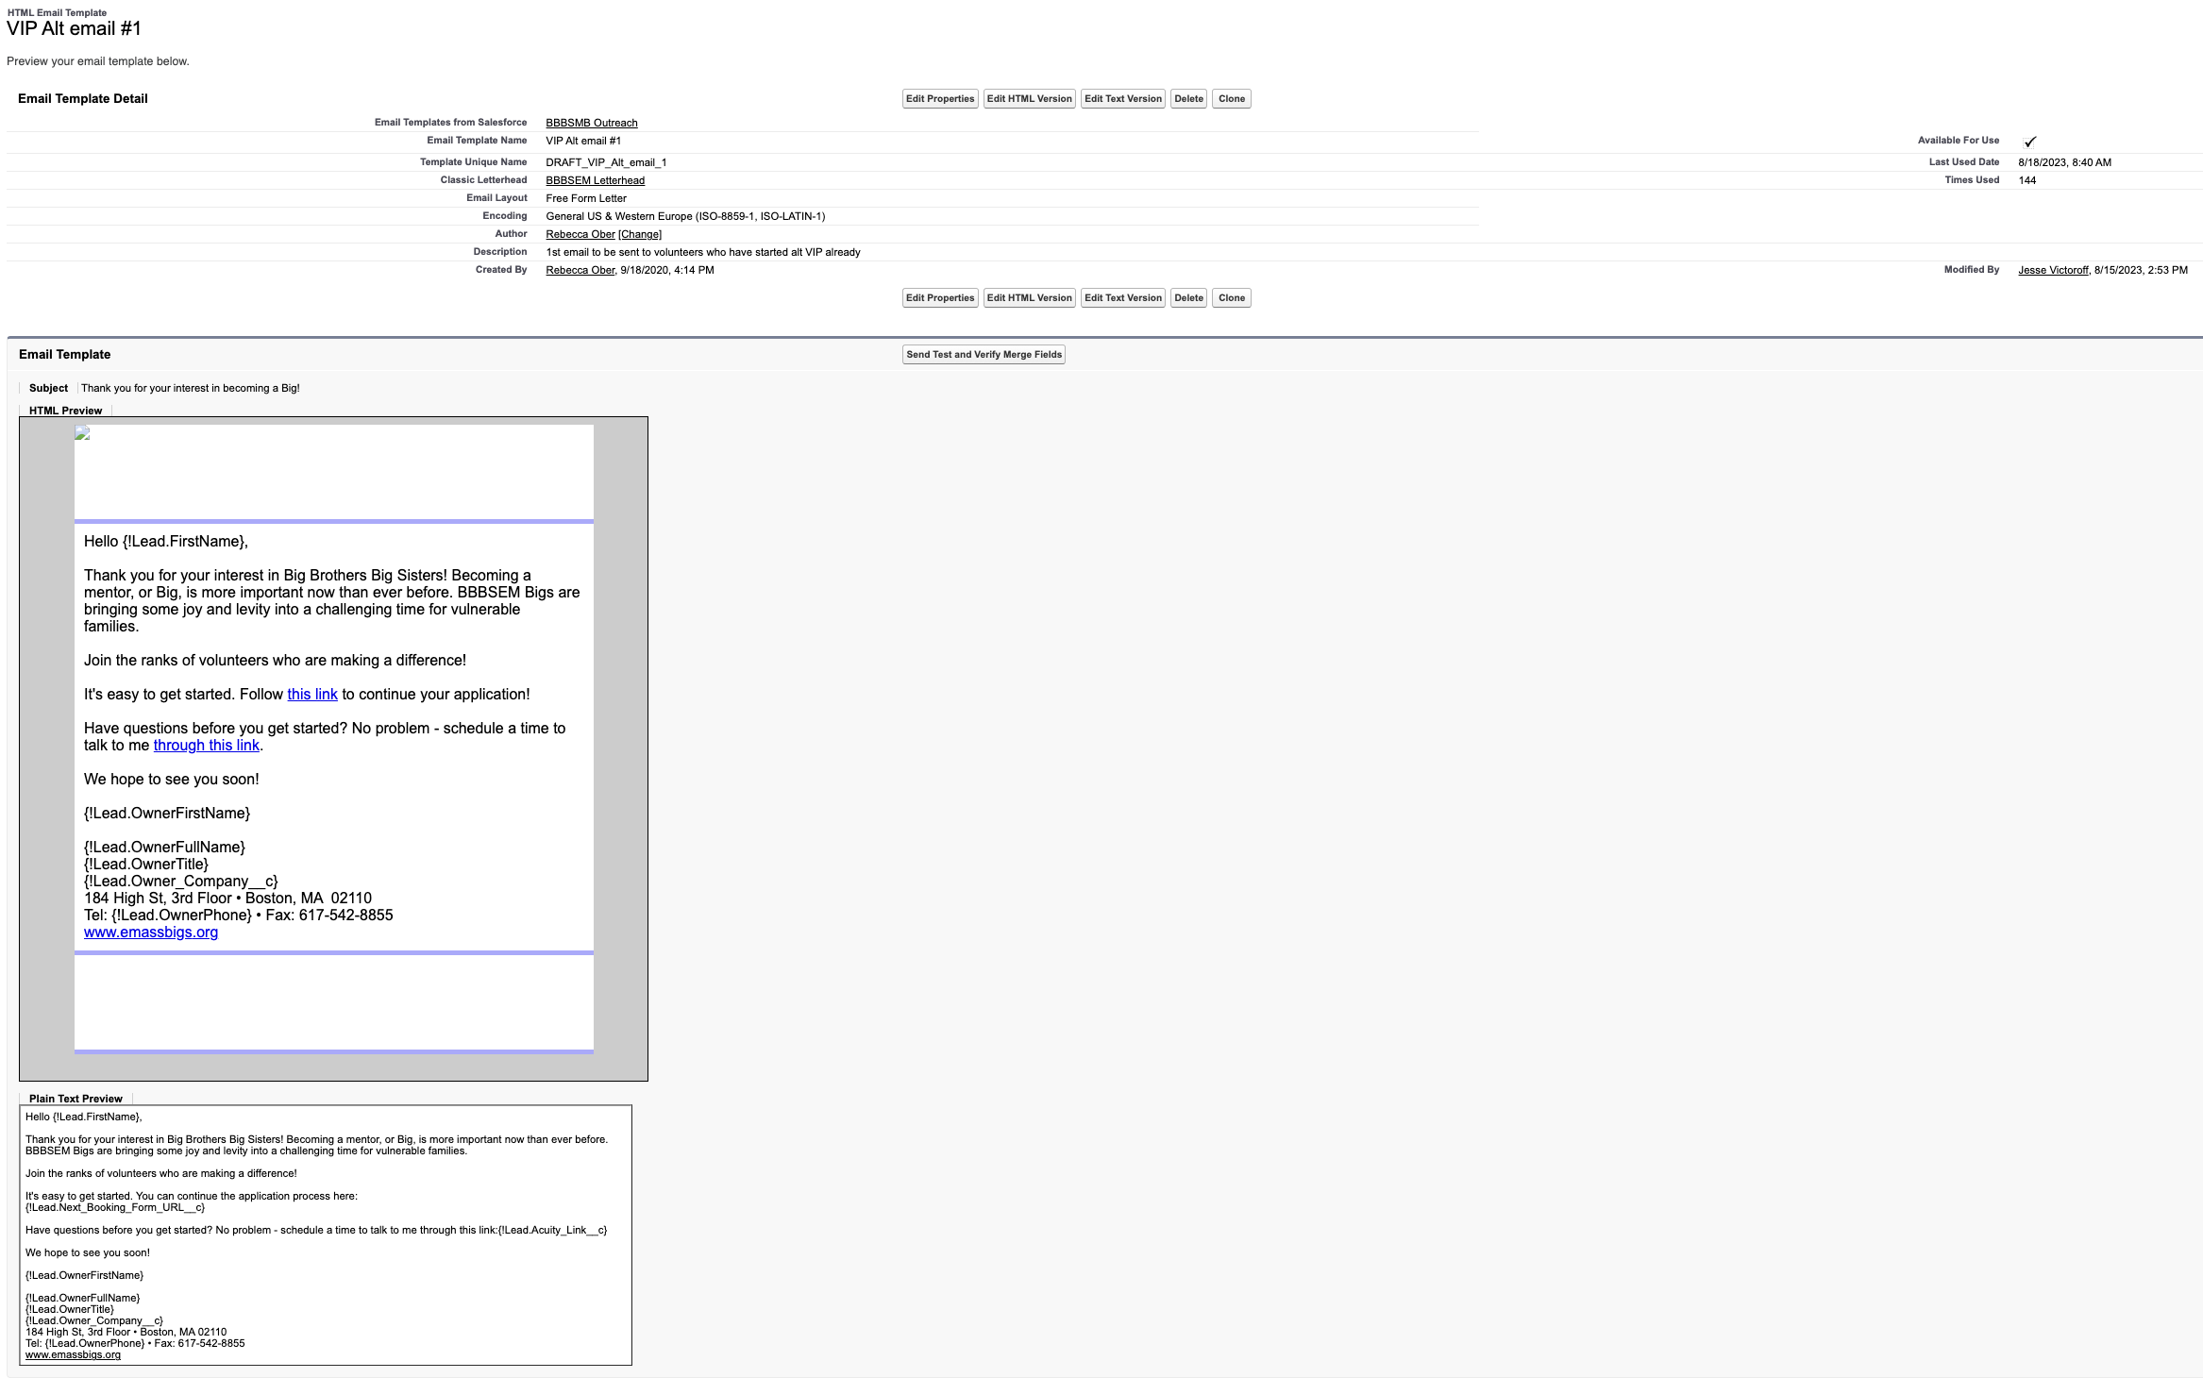
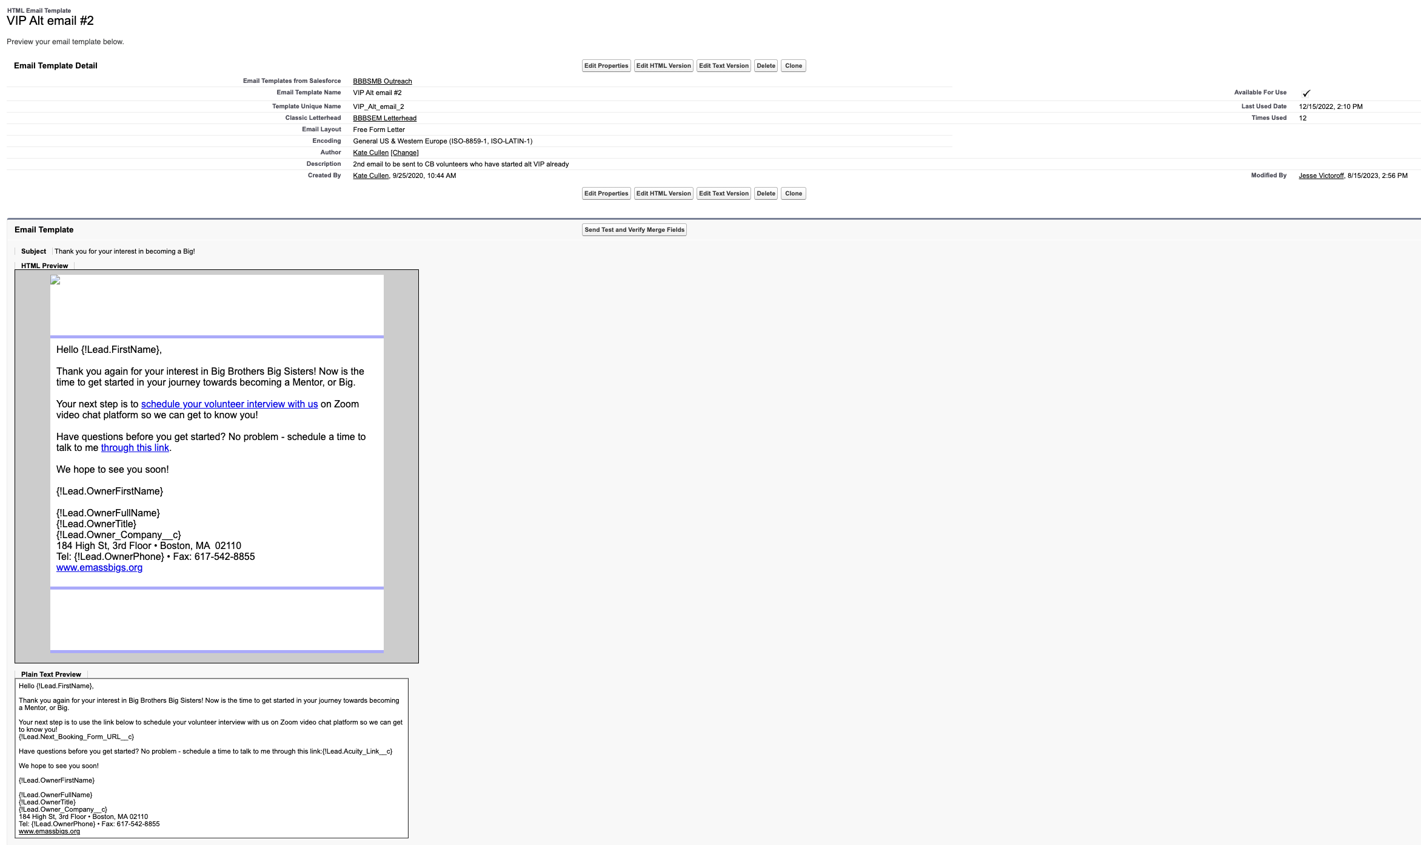
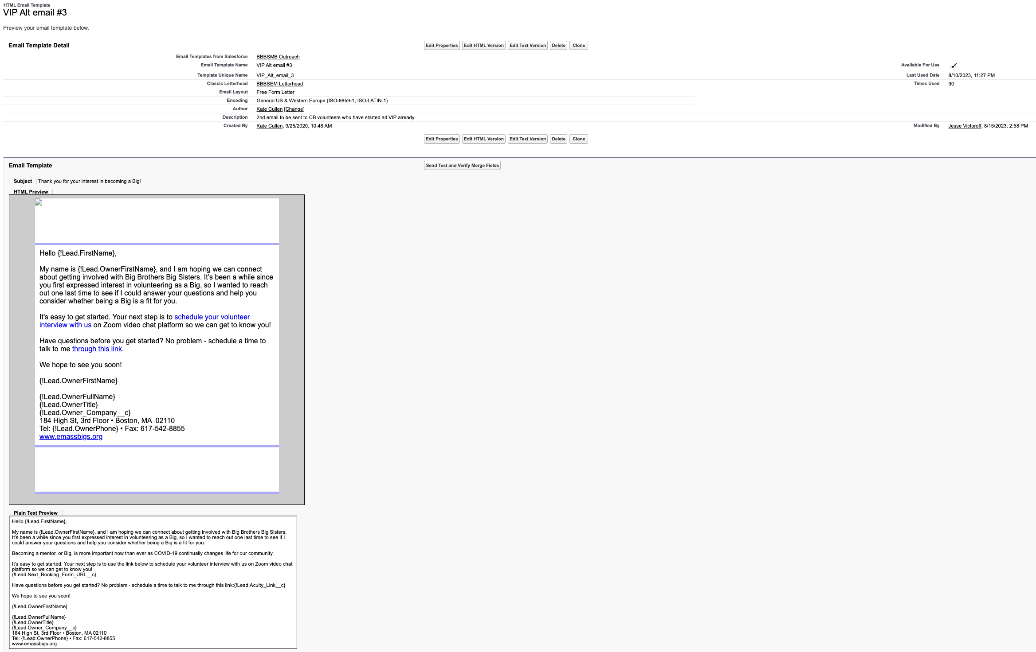
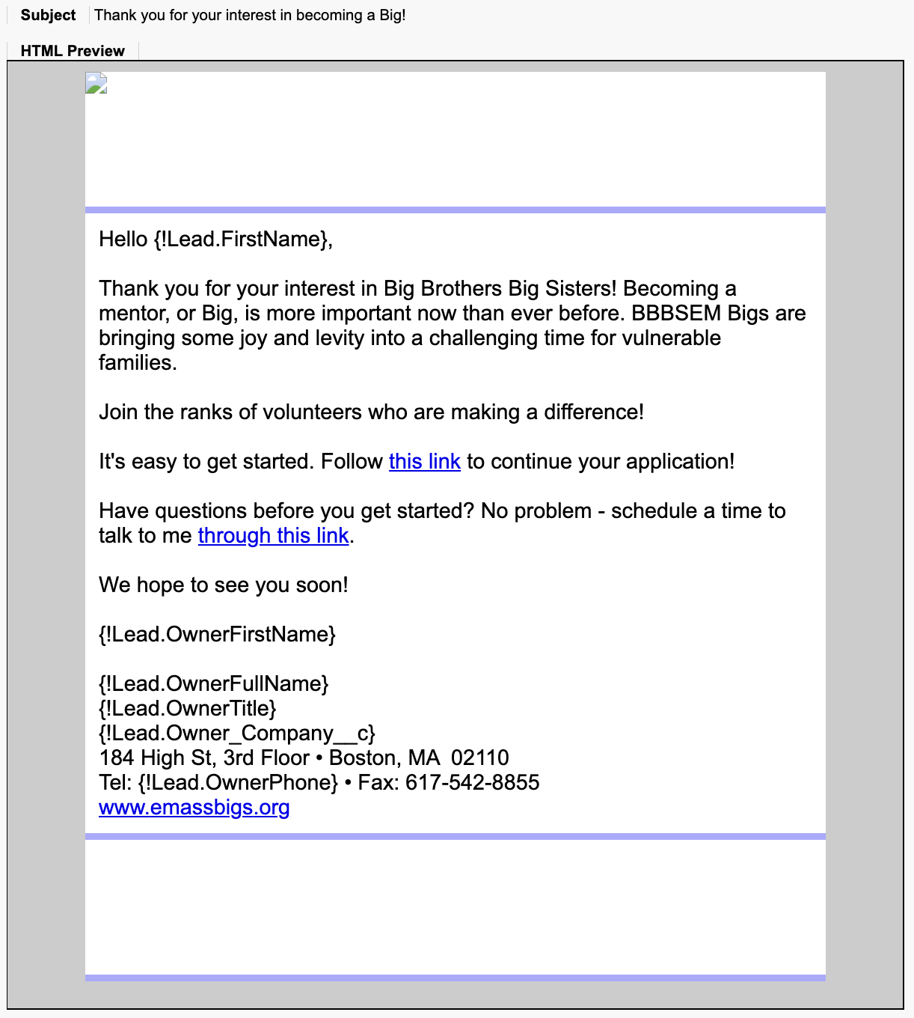
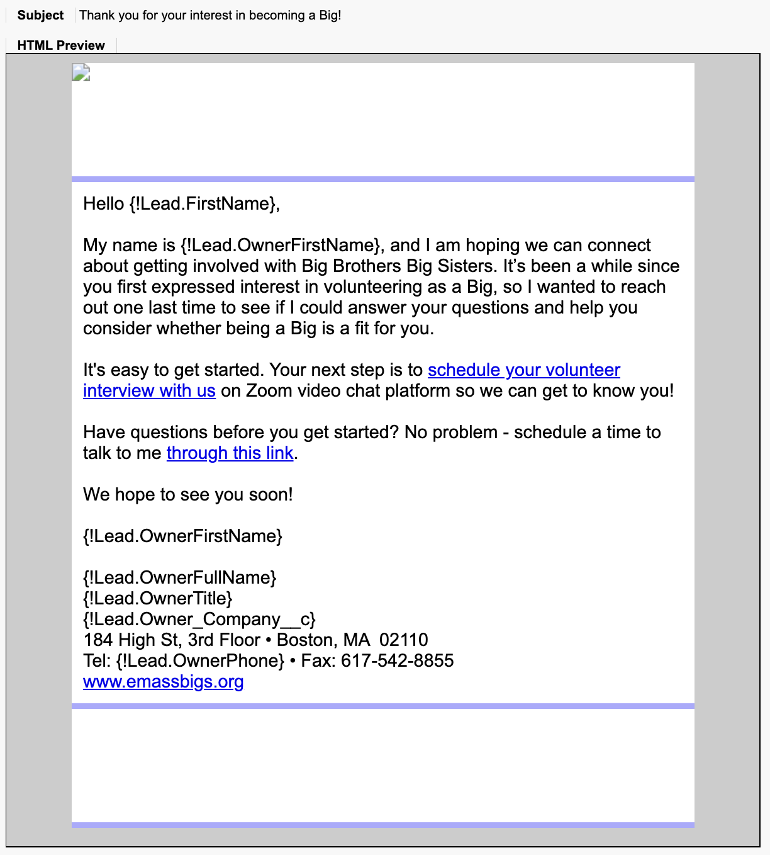
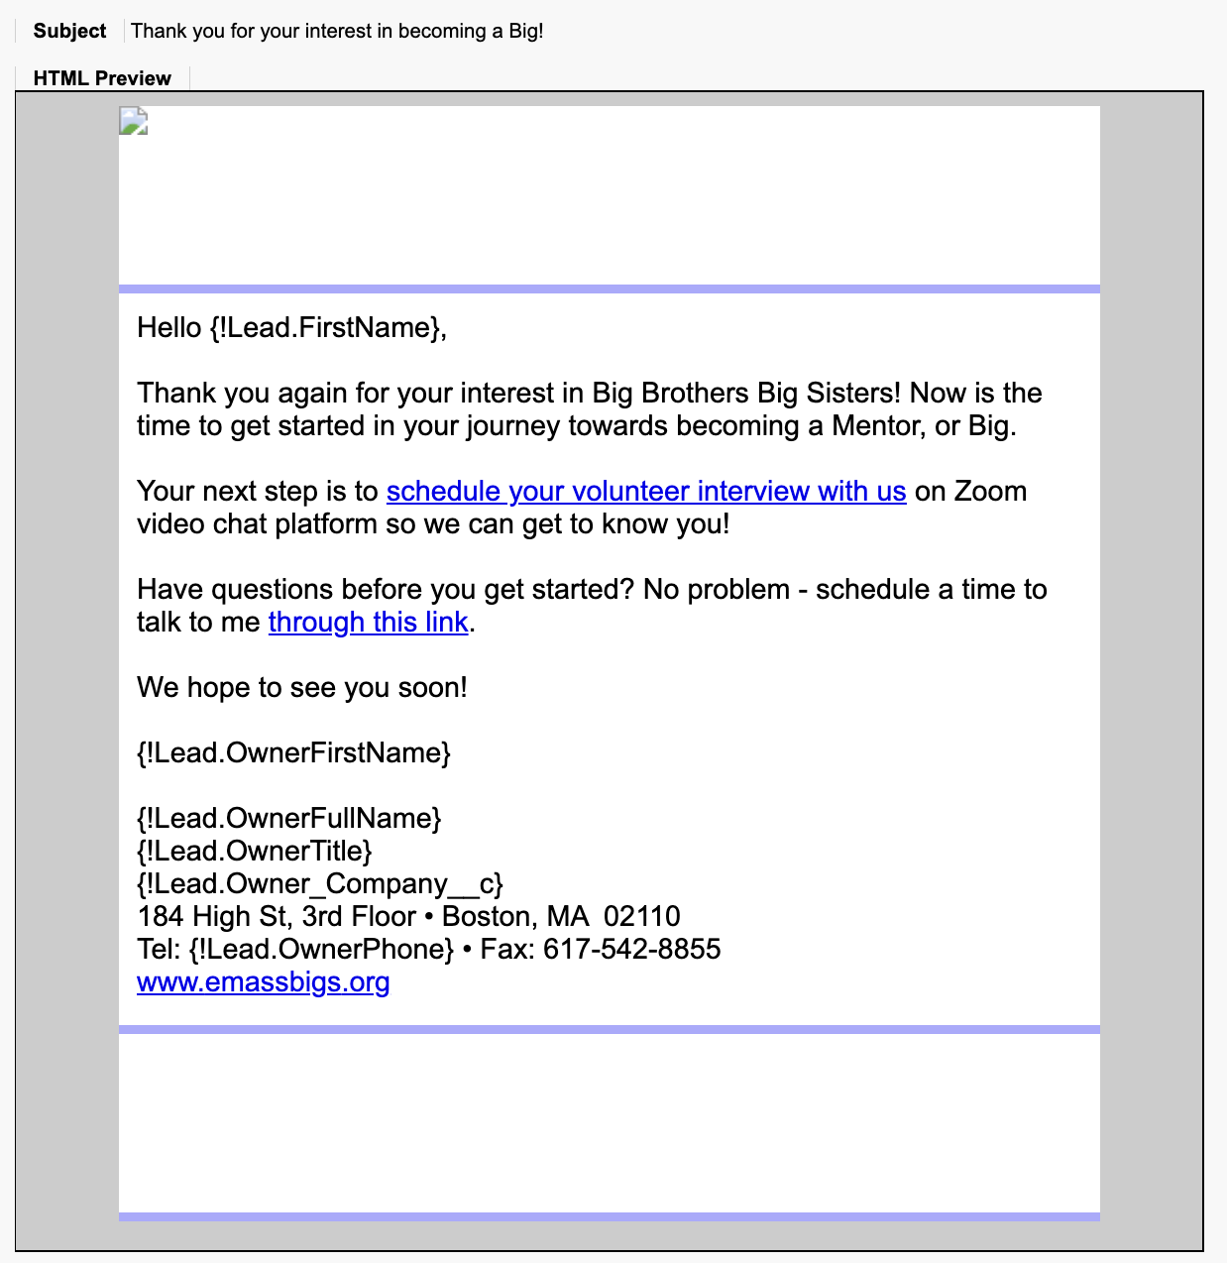
6. Default VIP Message
Template Name: VIP email 1
Flow Used: Volunteer Outreach || Immediate Actions - V16
Template Name: VIP email 2
Flow Used: Volunteer Outreach || Scheduled Actions - V19
Template Name: VIP email 3
Flow Used: Volunteer Outreach || Scheduled Actions - V19

Slide 38
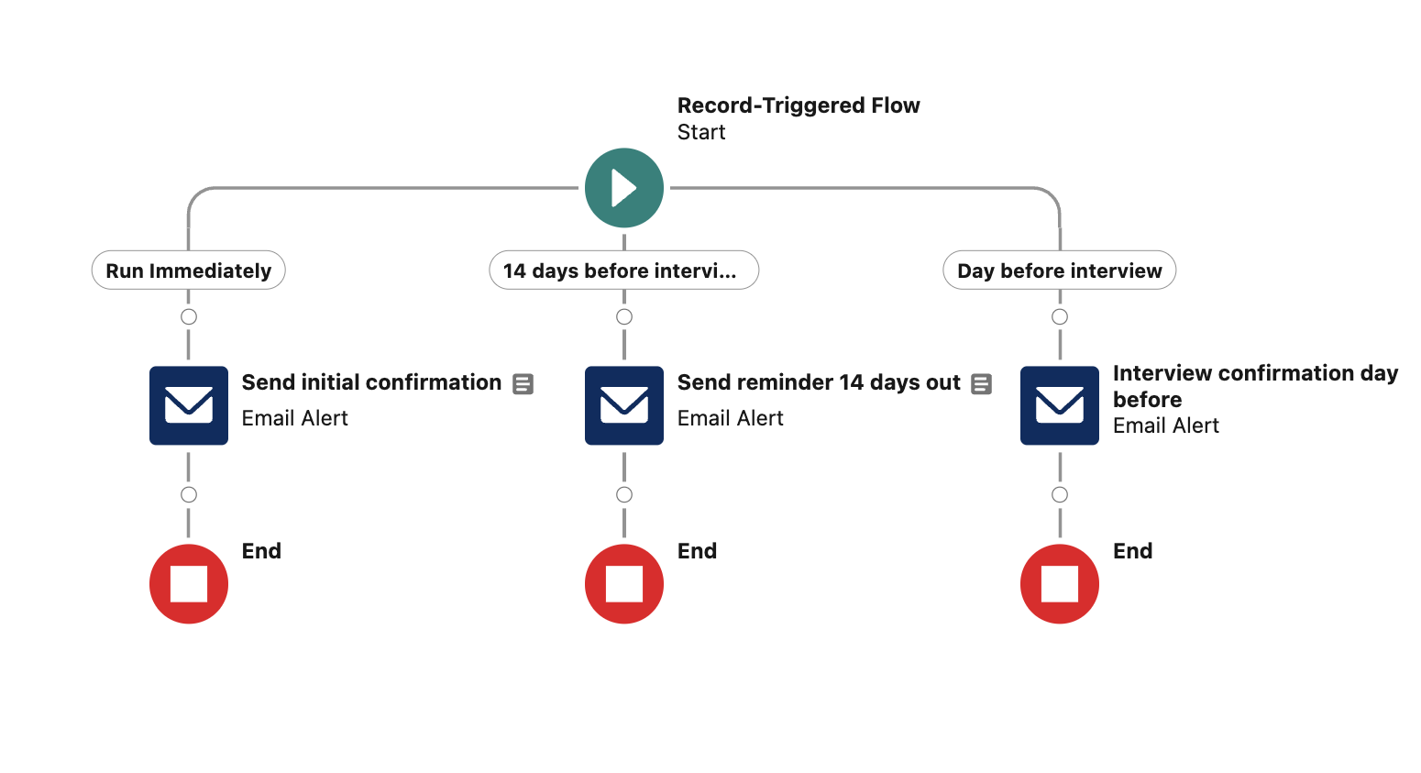
7 Interview Confirmed
Interview Confirmation – 60-minute pilot – V3
Bla
bla

Slide 39
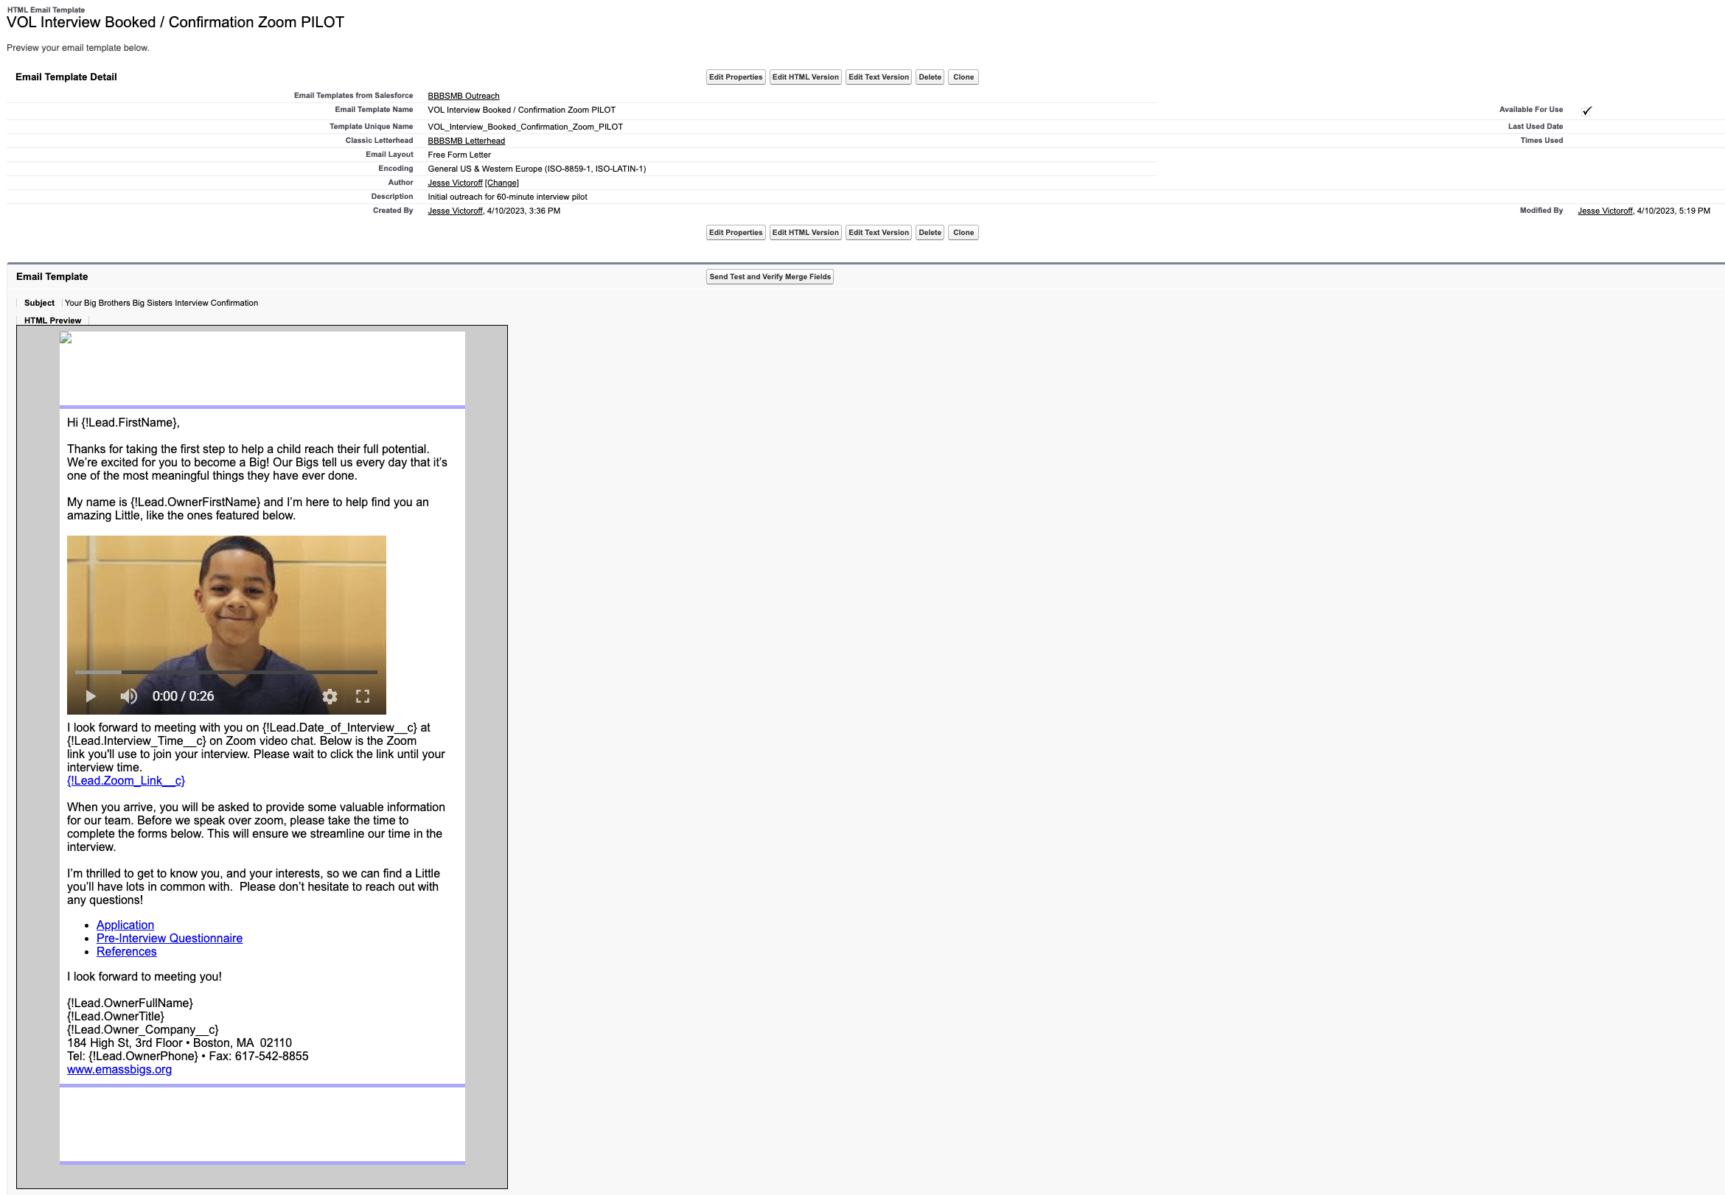
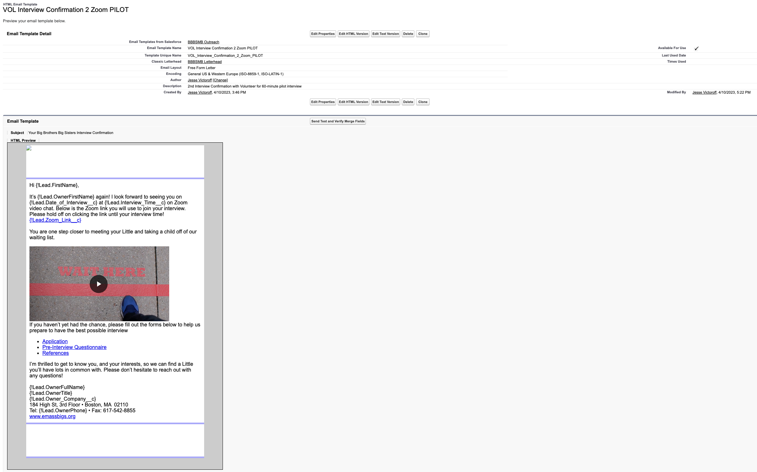

8 Interview Confirmed
Template Name: VOL Interview Confirmation 2 Zoom PILOT
Flow Used: Interview confirmation - 60-minute pilot - V3
Template Name: VOL Interview Confirmation Final Zoom PILOT
Flow Used: Interview confirmation - 60-minute pilot - V3
Template Name: VOL Interview Booked / Confirmation Zoom PILOT
Flow Used: Interview confirmation - 60-minute pilot - V3

Slide 40
Appendix F: Post - Interview

Slide 41
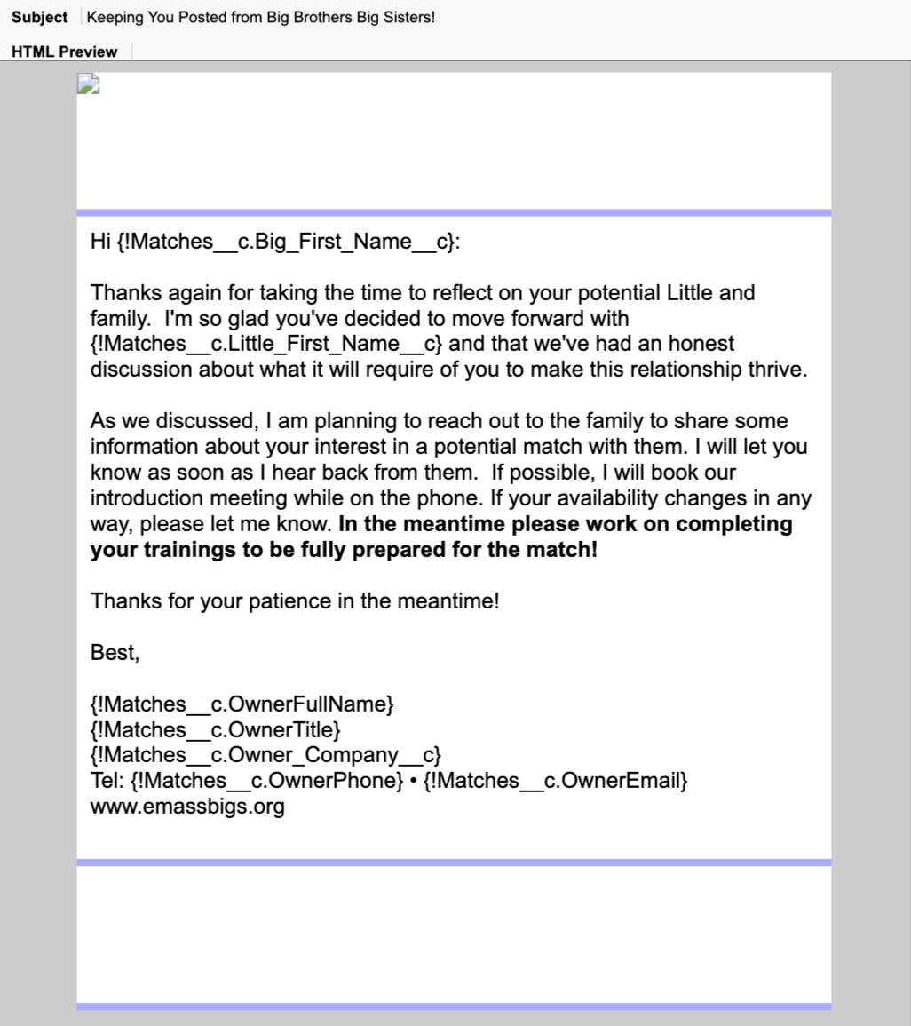
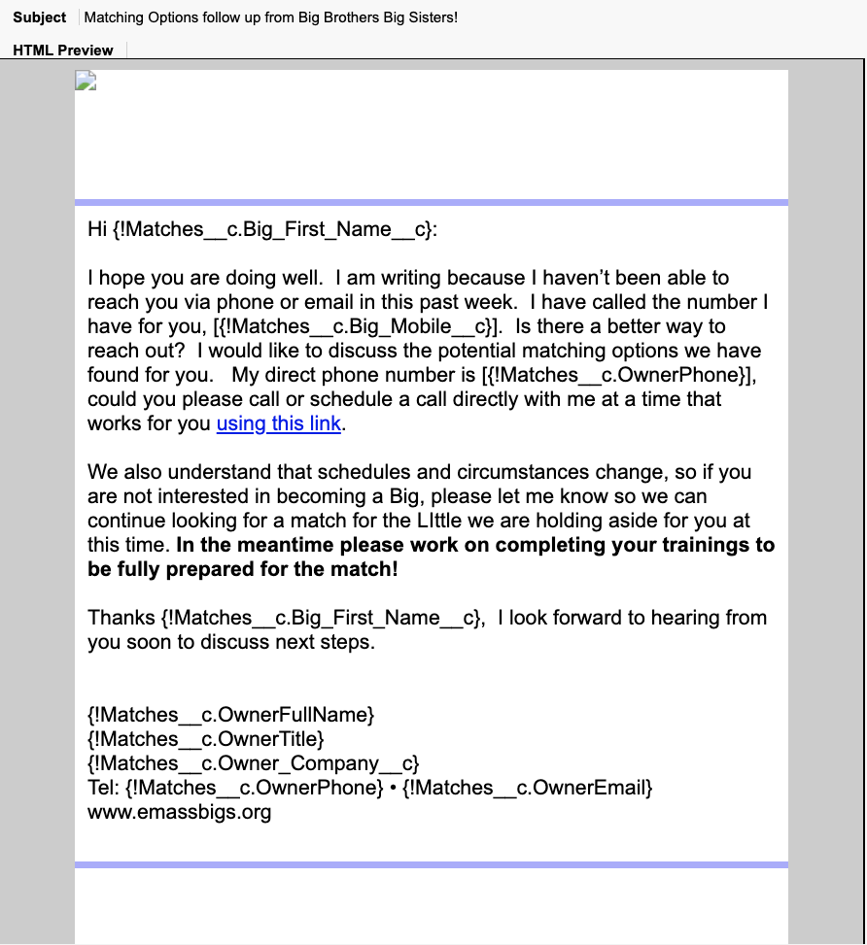
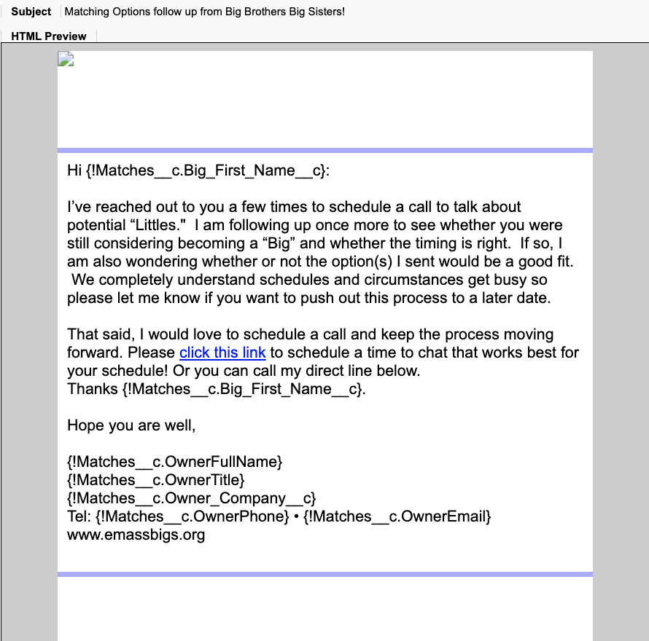
Appendix: Post – Interview Big Outreach – Not Responding
Template Name: Vol Presentation Follow up d1
Flow Used: No Flow Found
Template Name: Vol Presentation Follow up d6
Flow Used: No Flow Found
Template Name: Vol Presentation Follow up d11
Flow Used: No Flow Found

Slide 42
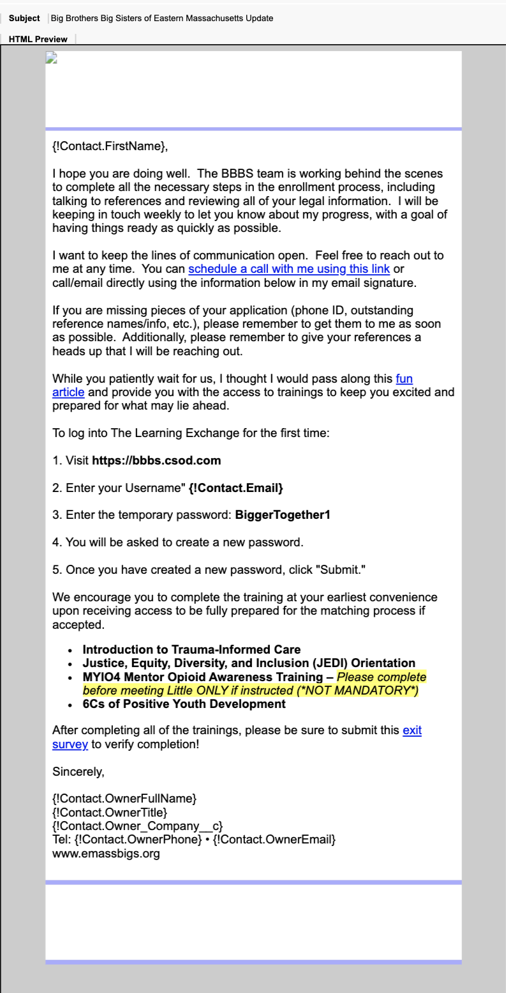
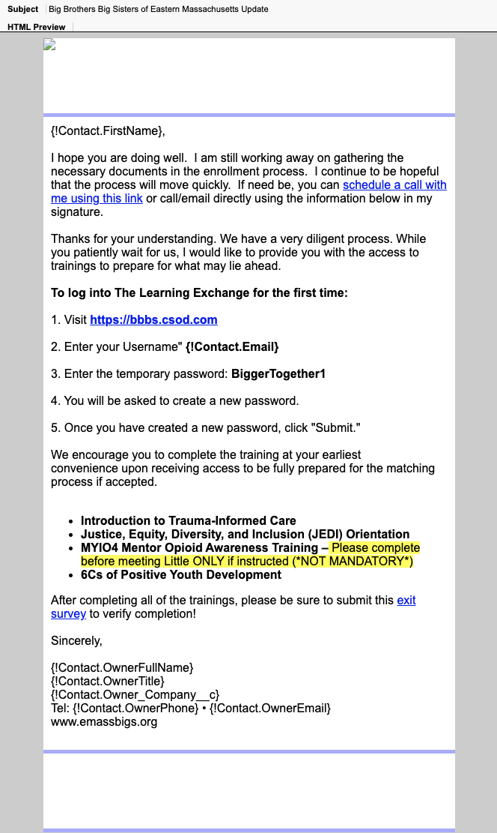
Appendix: Post – Interview Big Communication – Processing
Template Name: VOL Processing Email 1
Flow Used: No Flow Found
Template Name: VOL Processing Email 2
Flow Used: No Flow Found

Slide 43
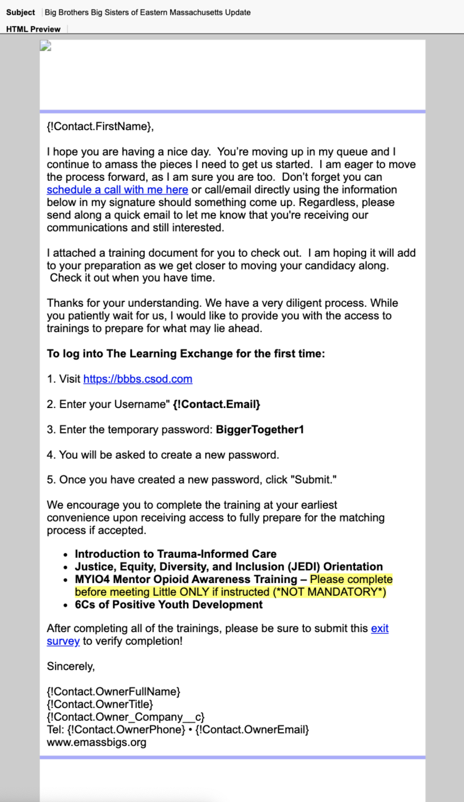
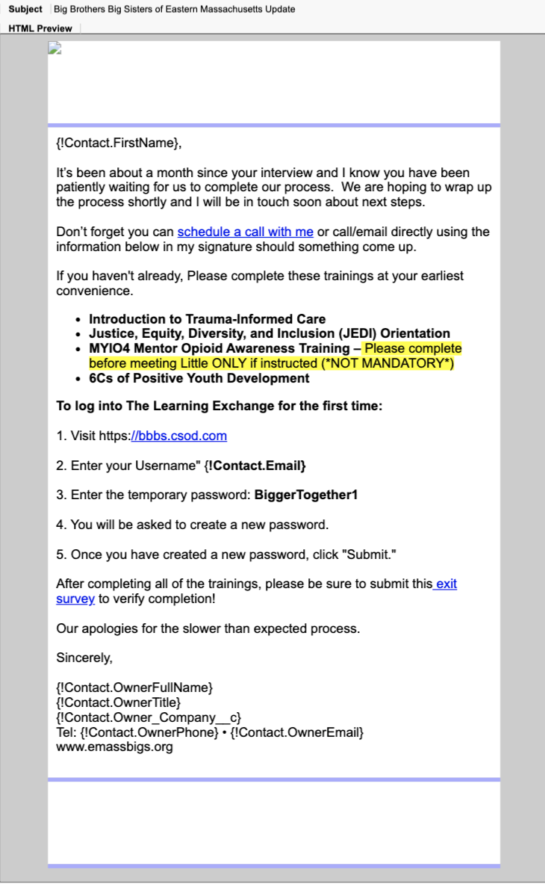


Appendix: Post – Interview Big Communication – Processing
Specific Pain Points identified in Templates
There is little difference between templates that essentially function as updates
Repetitiveness of email updates and lack of new information disengages volunteers
Indicates the email is automated, decreasing likelihood of volunteers reading it
Key Features of a Strong Email Template
Matches user needs and goals
Provides valuable updates
Includes interactive and engaging content
Template Name: VOL Processing Email 3
Flow Used: No Flow Found
Template Name: VOL Processing Email 4
Flow Used: No Flow Found

Slide 44
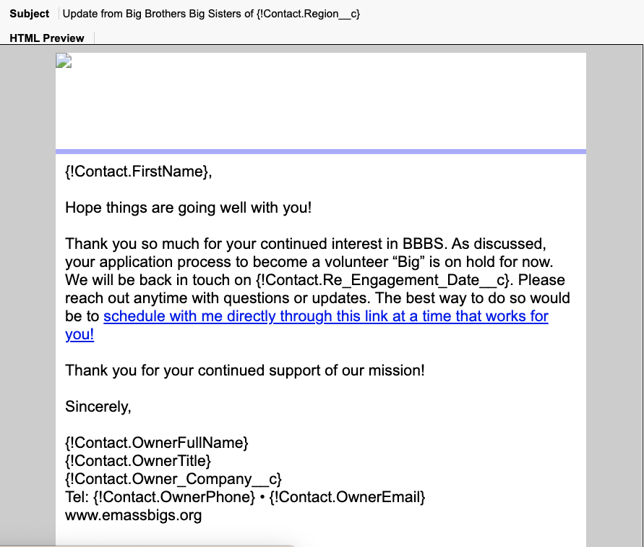
Appendix: Post – Interview Big Communication – On Hold
Template Name: VOL On-Hold Email 1
Flow Used: No Flow Found

Slide 45
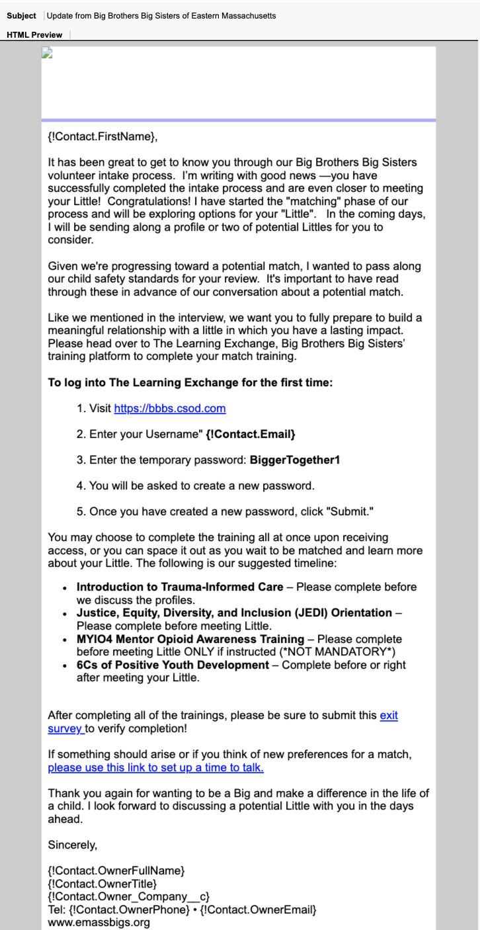
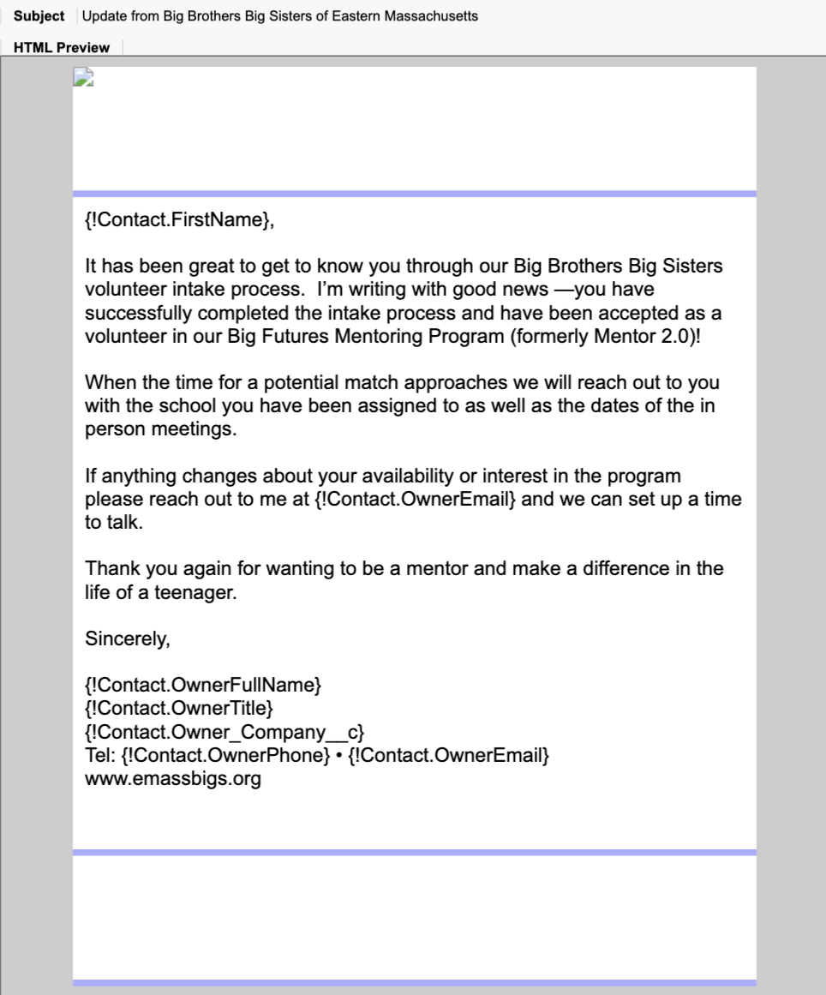
Appendix: Post – Interview RTBM Big Communication
Template Name: VOL CB RTBM Email 1
Flow Used: No Flow Found
Template Name: VOL m2.0 RTBM Email 1
Flow Used: No Flow Found

Slide 46
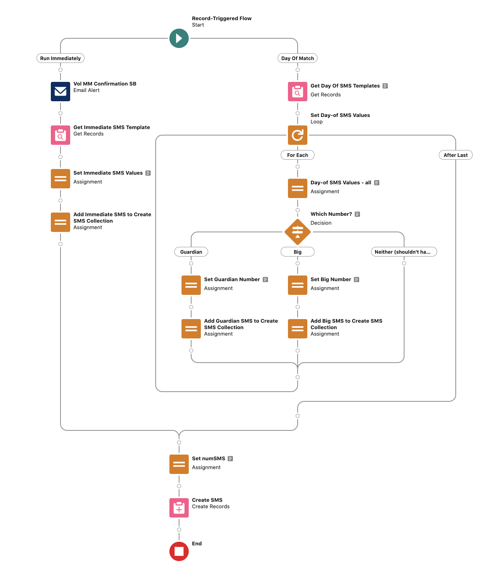

Appendix: Match Flow for Big Communication
Flow Name: Pending Match Outreach || Match || A C/U – v1
Template Name: Vol MM confirmation SB
Flow Used: Pending Match Outreach || Match || A C/U – v1

